Slide 1
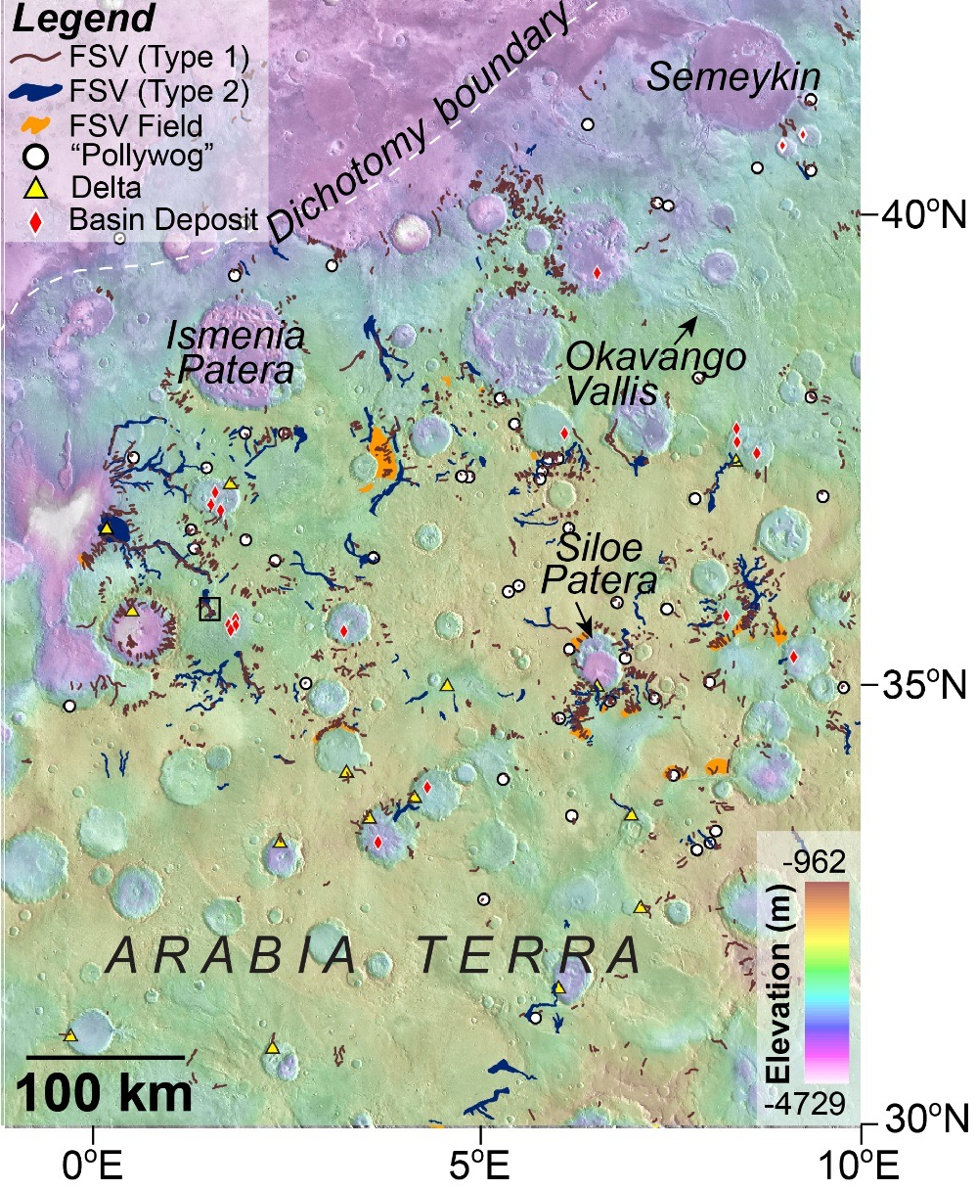
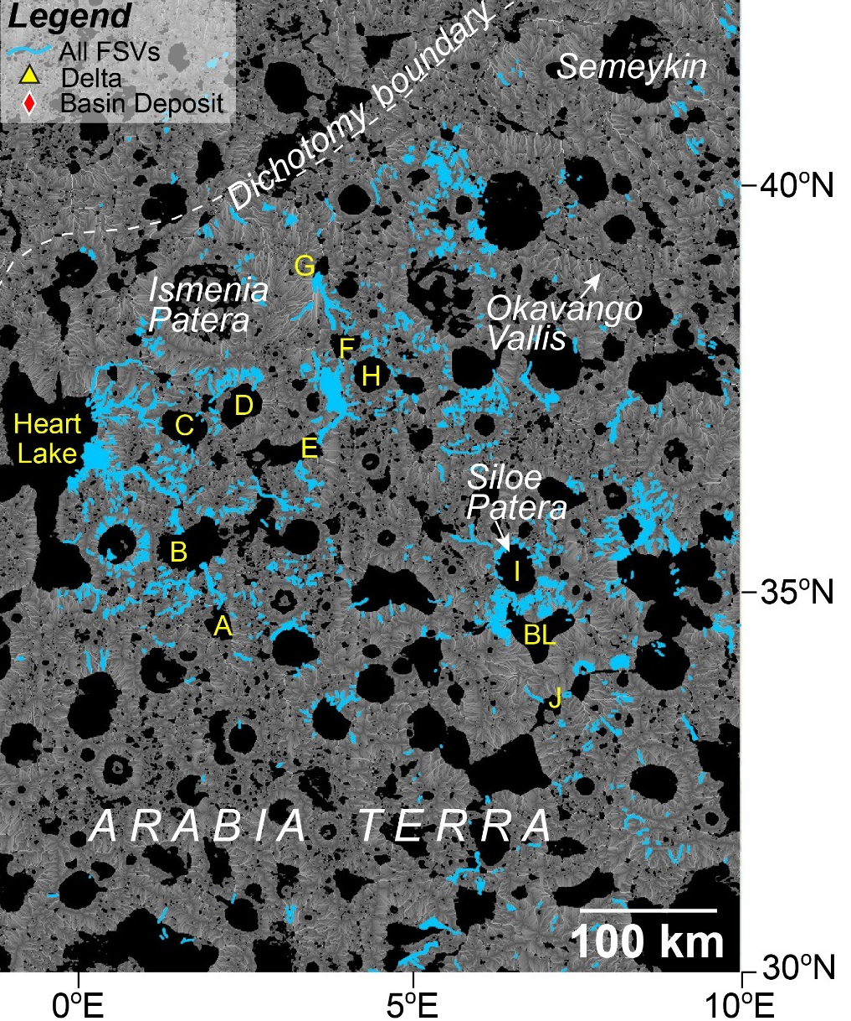
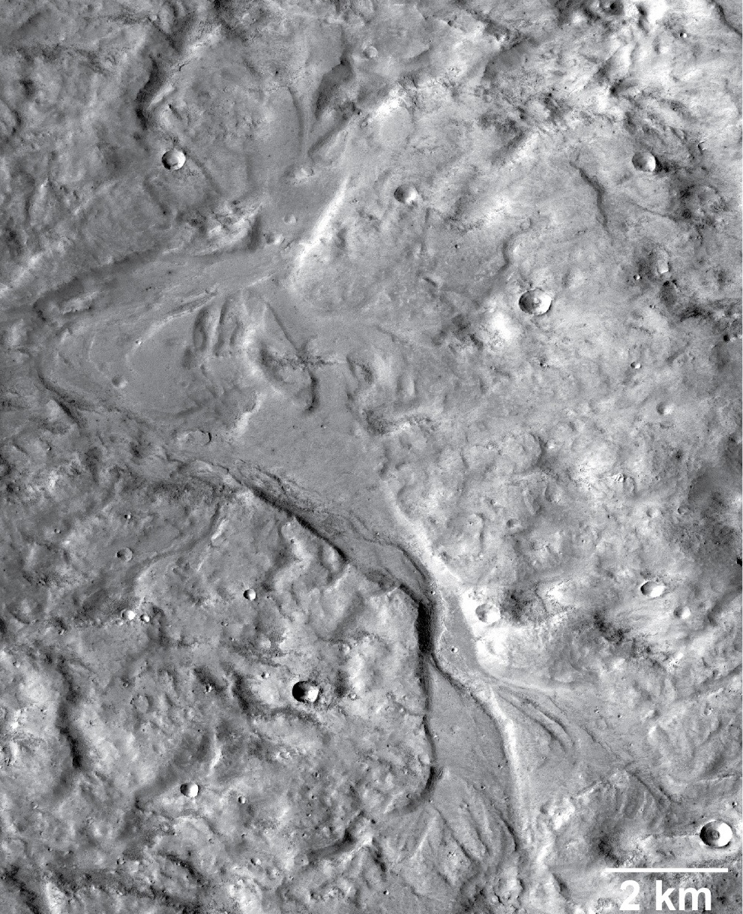


“Young” Valleys and Lakes in Northern Arabia Terra on Mars
A landscape modified by water and ice is an unambiguous marker of past climate
Northern Arabia Terra is located just south of the dichotomy boundary on Mars. This area has several fresh shallow valleys (FSVs), some of which flowed into and out of large paleolakes. This discovery suggests there may have been a global period(s) of warming that allowed ice to melt and water to flow and collect on the surface during a time that was thought to be too cold and dry for such activity. The paleolakes may have provided a safe place for microbial life to form and (or) survive, possibly extending habitable conditions on Mars into the Amazonian (up to around 2 billion years ago).
Map of study region showing high concentration of FSVs and associated landforms such as deltas. Color base is topography (see elevation scale).
Most FSVs (blue lines) stop at the edges of model-predicted paleolakes (black) and some flow into and out of paleolakes (e.g., see lake “B”).
Example of FSV that formed as water spilled over the northern margin of lake “B” (red box in middle panel). Water continued to flow downhill toward “Heart Lake” (see middle panel).
Wilson, S. A., A. D. Howard, J. M. Moore, and J. A. Grant (2016), A cold-wet middle-latitude environment on Mars during the Hesperian-Amazonian transition: Evidence from northern Arabia valleys and paleolakes, J. Geophys. Res. Planets, 121, doi:10.1002/2016JE005052.

