Slide 1

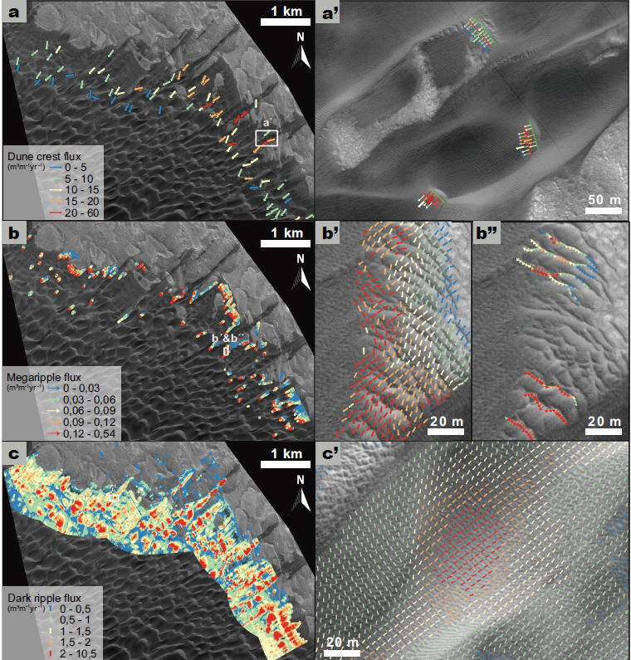
Widespread Megaripple Activity Across the North Polar Ergs of Mars
Sand Flux Comparisons (red is high, blue is low)
Matthew Chojnacki (Planetary Science Institute), David A. Vaz (Uni. of Coimbra), Simone Silvestro (SETI), David Silva (Uni. of Coimbra), (2021) JGR Planets
Dunes
Martian megaripples, which are intermediate-scale (5–40-m spacing, ∼1–2-m tall) wind-driven (aeolian) bedforms, have been studied extensively and thought to be largely inactive relics of past climates save for a few exceptions.
We mapped the extensive sand seas across the north pole of Mars for the presence of intermediate-scale bedforms of megaripples, which were found to be common landforms.
Using repeat HiRISE images acquired over long durations (6 Mars years or 13 Earth years) we examined the dynamic activity of polar bedforms. Remarkably, all the study sites investigated hosted migrating megaripples, indicating widespread and formative winds had occurred.
When comparing sand flux contributions of polar megaripples relative to smaller dark-toned ripples and larger dunes, they are estimated to contribute ~1% of the total aeolian system's sand fluxes. Overall, these findings support the notion of a very windy north polar environment.
1
2
Megaripples
3
Wind
Dark-toned ripples
3
Key Points:
Abundant megaripple populations were identified across the north polar ergs of Mars and found to be migrating with dunes and ripples.
Polar megaripple dynamics and sand fluxes are enhanced relative to lower-latitude sites, despite the shorter migration season due to polar ice.
Spring and summer winds and polar storms were attributed as the cause for the increased activity rather than ice-related processes.
1
2
See: Chojnacki et al. (2021) JGR-Planets; doi.org/10.1029/2021JE006970

