Slide 1
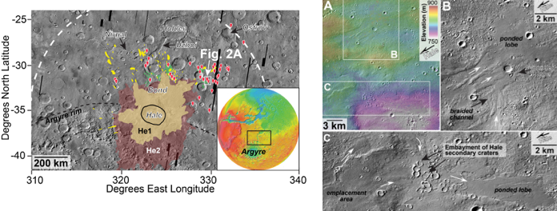

Water-Rich Flows over an Extensive Region around Hale Crater
Unique deposits provide a window into late climate on Mars.
Hale crater formed into an ice-rich terrain in the Early to middle Amazonian (Fig. 1) and is one of the youngest, largest (~125 km across), and best preserved craters on Mars. Discontinuous, initially water-rich deposits up to 450 km from Hale’s rim were ballistically emplaced and flowed for hours up to a day or two after impact (Figs. 1 and 2). The pristine nature of these deposits indicates: erosion rates were low after the Hale impact, Hale’s formation post-dates regional alluvial fan activity, and crater formation did not influence global or regional scale geomorphic activity or climate for any extended period of time.
Figure 1. Hale crater is on the northern rim of Argyre basin (see inset for global context). Newly identified distal discontinuous ejecta deposits (red pins and green units) occur well beyond the continuous ejecta (He1, He2), embay Hale secondary craters (yellow blobs), and flowed after late-stage ballistic emplacement. Major place names labeled for context. White box shows Fig. 2A.
Figure 2. A) Discontinuous distal deposits ~315 km northeast of Hale flowed downhill and ponded in low-lying areas. B) and C) Detail of channels (white arrows), and smooth ponded lobes that often fill and embay secondary craters from Hale crater.
Grant, J. A. and S. A. Wilson (2017), Meteoritics and Planetary Science (in press).

