Slide 1
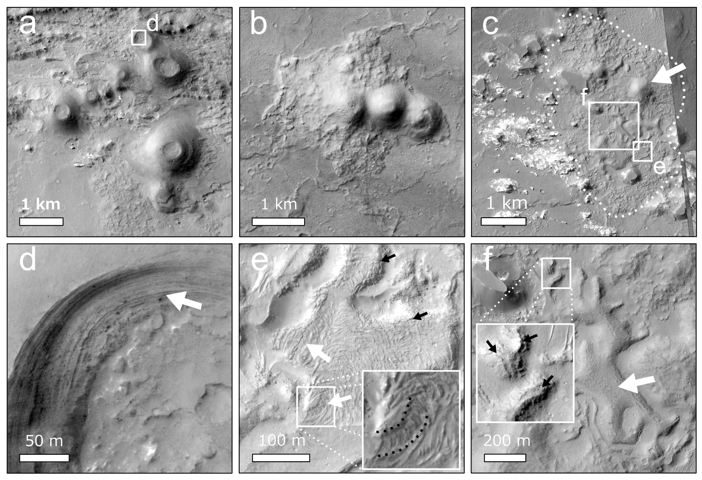
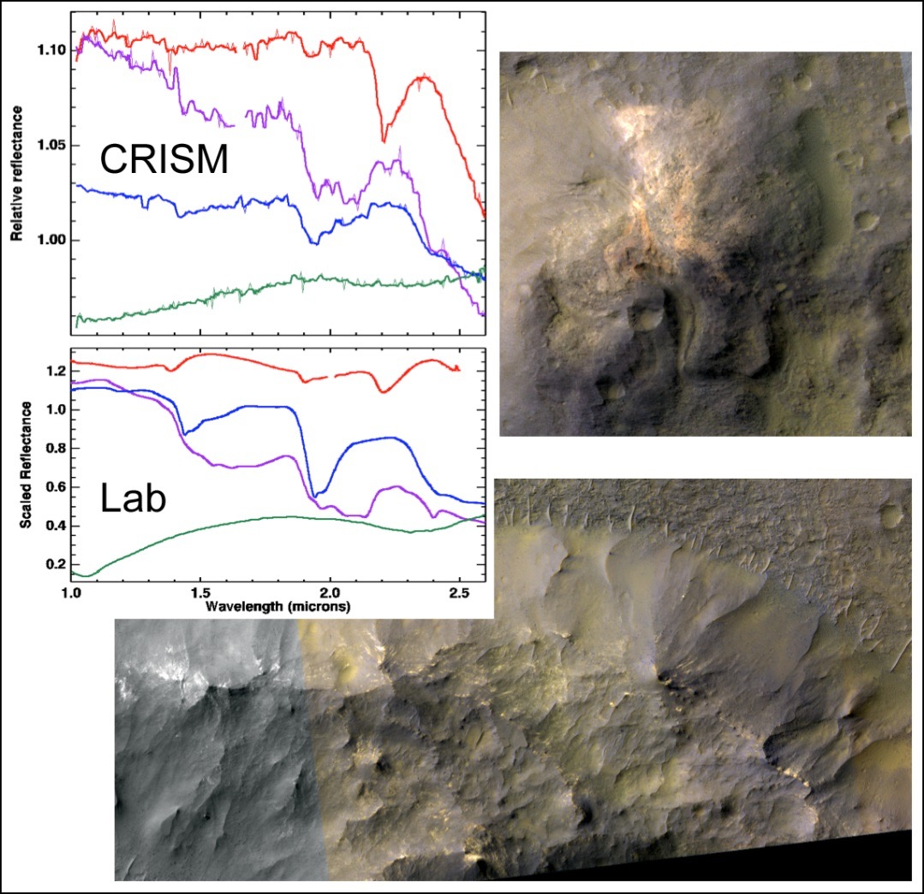



Volcanism and Hydrothermal Activity in Valles Marineris
Groups of pitted cones and associated flow features in Coprates Chasma morphologically resemble scoria and tuff cones, and lava flows [left image].
Alternatively, the landforms have been interpreted as mud volcanoes (Okubo, Icarus, 2016).
Due to morphological observations (based on HiRISE and CTX), textural characteristics of the flow unit surfaces, and possible flow inflation, we favour igneous volcanism as the most plausible mechanism. Moreover, the features are very similar to analogous igneous landforms elsewhere on Mars where sedimentary volcanism is unlikely.
Dating by crater counts yields relatively young middle- to late Amazonian ages, younger than most of Valles Marineris.
Spectral data (CRISM) reveal opaline silica-rich material, possibly indicative of hydrothermal processes [right image].
Brož, P., Hauber, E., Wray, J., Michael, G. (2017) “Amazonian volcanism inside Valles Marineris on Mars”
Earth and Planetary Science Letters, 473, 122–130, doi: 10.1016/j.epsl.2017.06.003.

