Slide 1
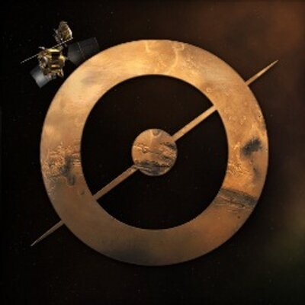
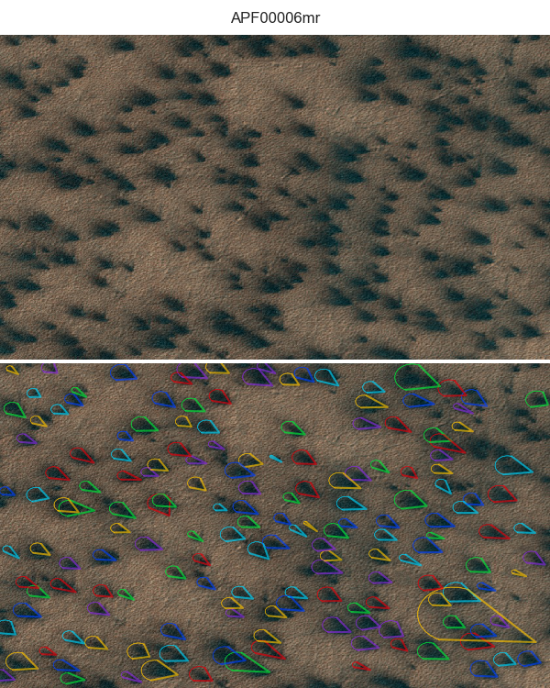
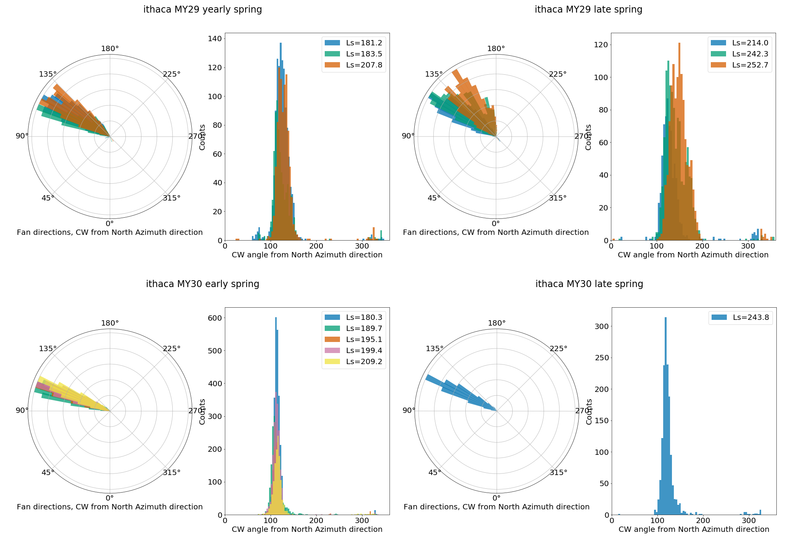
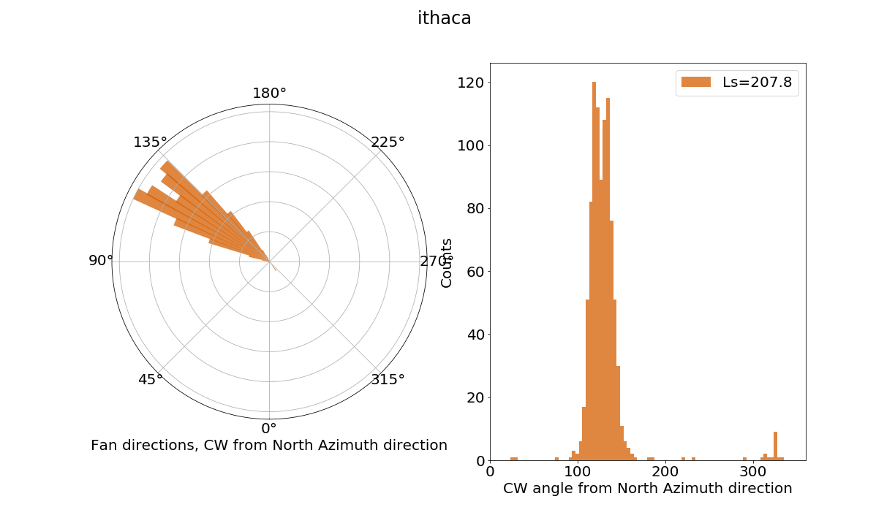
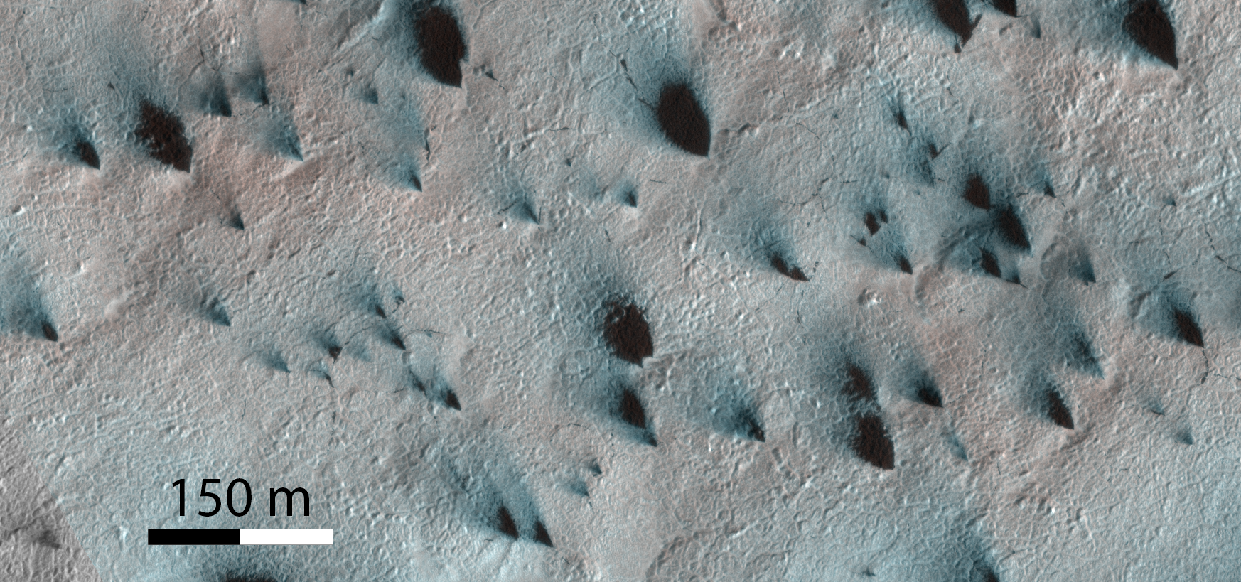


Seasonal Winds on Mars
Fans mapped by Citizen Scientists
Fans of dirt pop out from under dry ice onto Mars’ seasonal CO₂ polar cap every spring. The fans are like windsocks – they mark the direction of the wind at the time of the eruption. Planet Four enlists the general public to map the shapes, directions, and sizes of the seasonal fans visible in orbital images (www.planetfour.org) taken at different times throughout the spring. Over 80,000 volunteers have contributed to the Planet Four project, reviewing 221 HiRISE images, taken in southern spring during Mars Years (MY) 29 and 30. Multiple volunteer assessments were combined to generate a catalog of ∼ 400,000 south polar seasonal fans.
Rose diagrams showing the
dominant directions of fan
deposits (i.e. to where winds blew)
Top: Input tile as seen by volunteers;
Bottom: Overlaid clustering results showing fan directions as marked by Planet Four citizen scientists.
Top: Fan directions derived by Planet Four in Ithaca region in mid-spring.
Bottom: a subframe of the HiRISE image that can be directly compared to the wind diagram in the top panel.
Direction of fan markings in Ithaca region for early and late spring of MY29 and MY30.
ESP_011931_0945
The Planet Four fan catalog is a resource for studying polar winds, climate and polar processes. Using south polar fans as regional wind markers, the Planet Four catalog can provide tests for and input to global and regional atmospheric circulation models to study the weather on Mars.
K.-Michael Aye, et al., “Planet Four: Probing Seasonal Winds on Mars by mapping the southern polar CO2 Jet Deposits”, Icarus 319:558 (2019)

