Slide 1
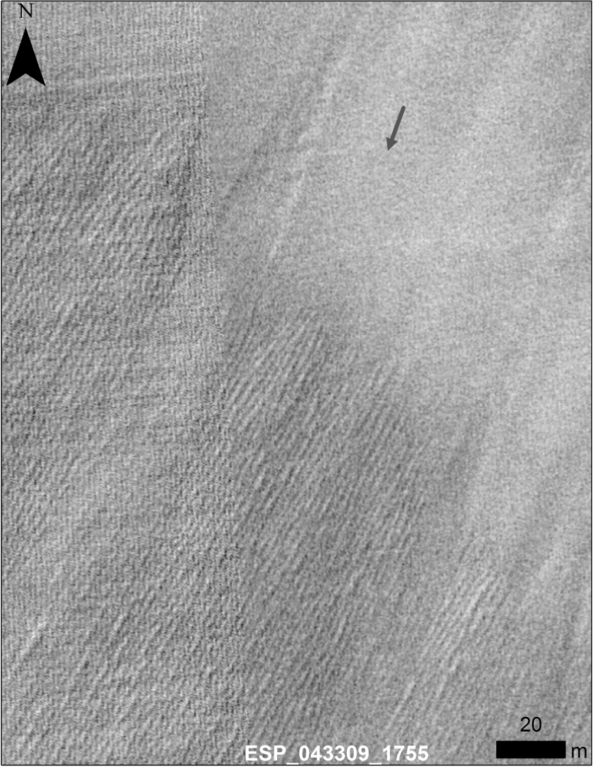
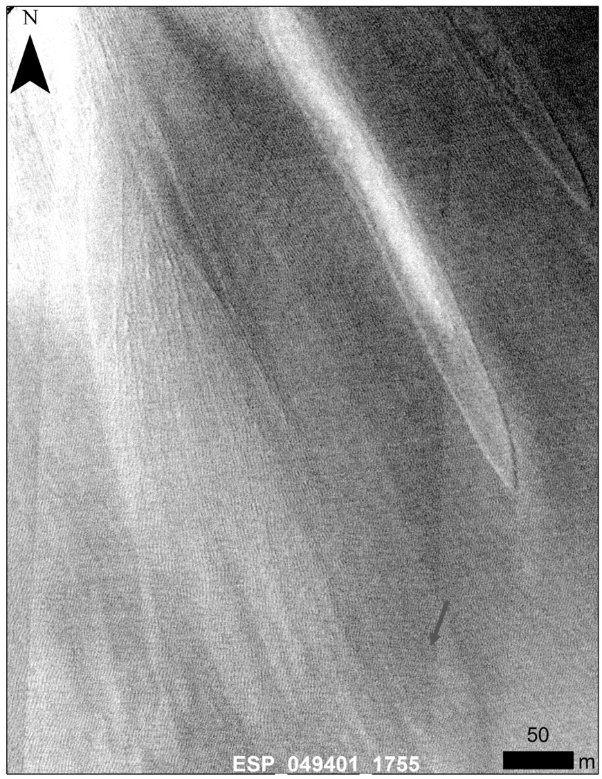
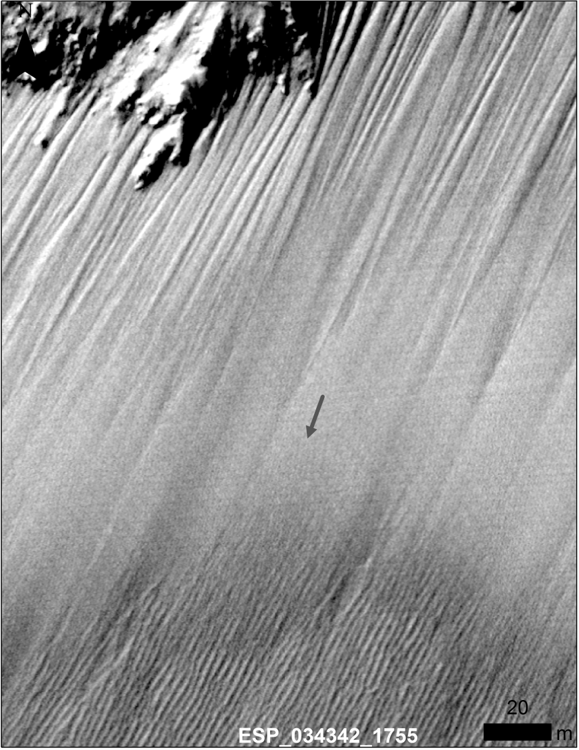
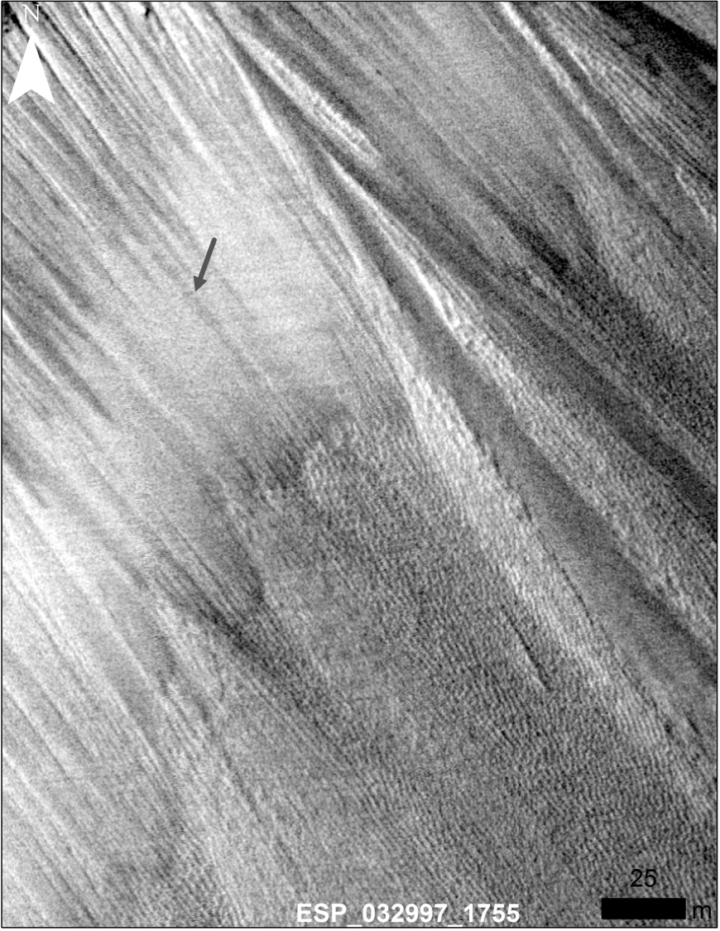
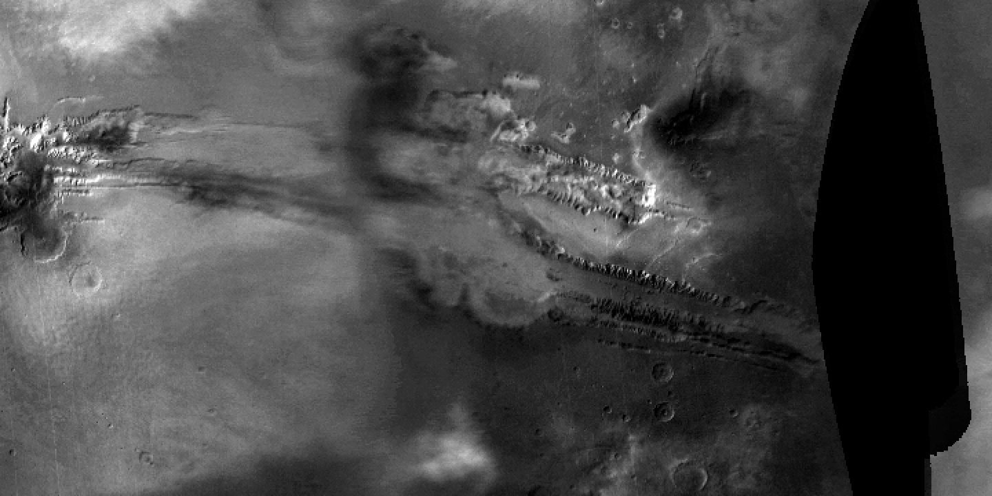


Seasonal Slumps in Juventae Chasma, Mars
Introduction: Dark topographic slumps several meters wide, tens of meters in length and up to a meter in depth are observed on the slopes of one hill in Juventae Chasma (JC), Valles Marineris (VM), Mars.
The slumps are seasonal features: Over the course of three Mars years, the High Resolution Imaging Science Experiment (HiRISE) camera captured ten active slumps in JC, all of which formed in or near the coldest time of the year.
Association with recurring slope lineae (RSL)?: These slumps usually originate near the terminal points of RSL often after they have faded.
Association with atmospheric phenomenon?: Low-altitude atmospheric obscurations are also observed when the slumps form. In one instance, data from the Compact Reconnaissance Imaging Spectrometer for Mars (CRISM) and Mars Color Imager (MARCI) suggest the presence of H2O-ice in the atmospheric obscuration.
Formation mechanism?: The presence of atmospheric obscurations at times when the slumps form is intriguing, but no direct evidence currently exists to support that they aid in slump formation. Further monitoring of this site will help establish if RSL and/or atmospheric events play a role in the creation of contemporary slumps.
Right: Animation of 4 slumps in HiRISE images of Juventae Chasma.
Left: An example of low-elevation atmospheric obscuration event in VM and JC from MARCI images.
L. Ojha et al., JGR-Planets doi: 10.1002/2017JE005375
HiRISE, CRISM and MARCI are onboard the Mars Reconnaissance Orbiter (MRO).

