Slide 1
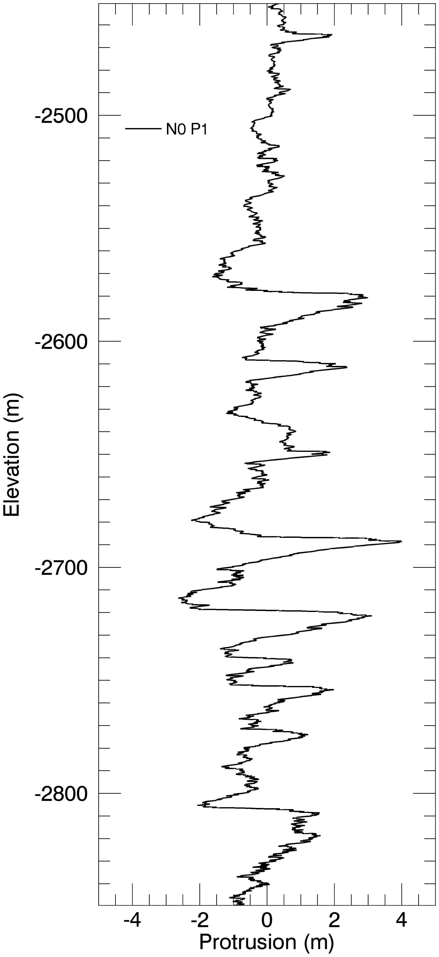
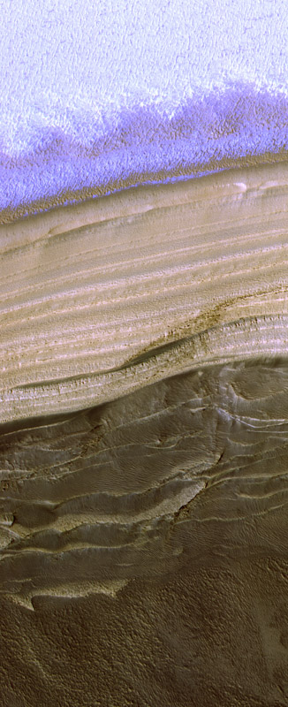


Mars’ Polar topography reveals astronomical forcing of climate
Analysis of the topography of exposures of the icy layers of Mars’ North Polar Cap connects periodic changes in layer properties to the oscillation of Mars’ orbit and rotation.
On Earth, climate variations (recorded in ice cores) result in part from orbital oscillations. Separating this from the effects of oceans, life and humans is complex, but Mars offers a natural laboratory where this is possible.
Mars’ climate oscillates as its orbit and spin axis change with periods of 51,000 and 120,000 years. These are expected to affect polar layered ice since it’s discovery 45 years ago, but this link has never been unambiguously demonstrated.
HiRISE can image these layers (left image) in stereo so they can be read like ice cores on Earth. With these data (right image) we can find overlapping periodicities in the stratigraphy. Using climate models, two dominant signals in the stratigraphy were matched to two dominant signals in the orbital history of Mars.
These new findings allow us to confidently connect Martian polar ice layers with specific dates for the first time.

