Slide 1
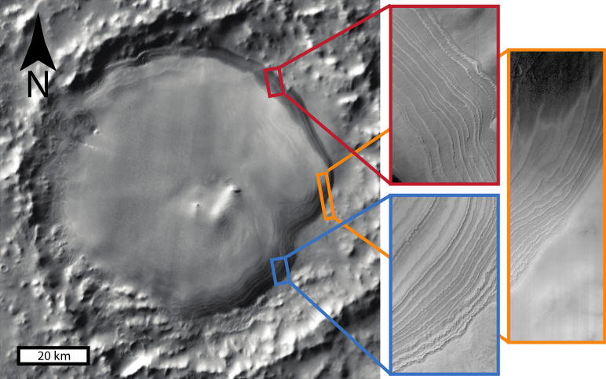


Orbital forcing of Martian climate revealed in a south polar outlier ice deposit
THEMIS background image with HiRISE insets
ESP_057848_1080
We made HiRISE DEMs and found that the topography of the ice mound has repeating patterns at wavelengths of 15.6 m and 6.5 m. The ratio is the same as the ratio of Mars’ orbital precession and obliquity changes.
$$\frac{15.6m}{6.5m}=\frac{120000yr}{51000yr}=2.4$$
This result suggests orbital control of recent Martian climate, implying an accumulation rate of 0.13 mm/yr over 4.5 Myr in this region. Likely a different record than the nearby south polar cap!
ESP_057439_1075
ESP_058362_1070
An ice mound in Burroughs Crater at 72°S, 117°E contains a fantastic layered paleoclimate record, decipherable at HiRISE resolution.
Published open access: Sori, M.M., P. Becerra, J. Bapst, S. Byrne, and R.A. McGlasson (2022), Geophysical Research Letters 49, e2021GL097450.
We acknowledge NASA MDAP grant 80NSSC17K0510, and Riley McClurkin, Kris Akers, and Shavonne Morin for DEM production.

