Slide 1
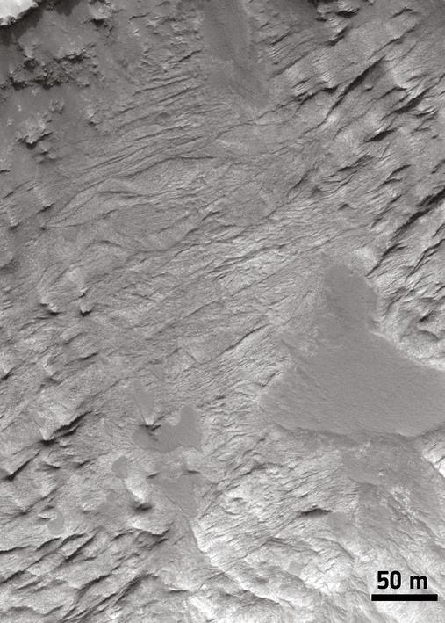
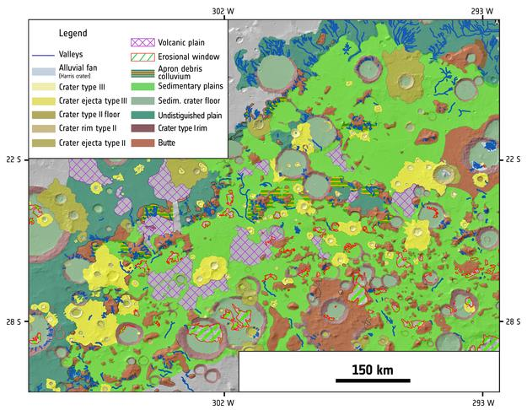
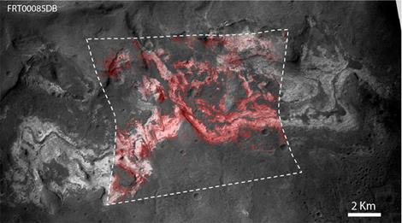

New evidence for a warmer and wetter early Mars
F. Salese, V. Ansan, N. Mangold, J. Carter, A. Ody, F. Poulet, and G. G. Ori, “A sedimentary origin for intercrater plains north of the Hellas basin:
implications for climate conditions and erosion rates on early Mars”, J. Geophys. Res., doi:10.1002/2016JE005039.
Original press release on the ESA website: http://sci.esa.int/mars-express/58613
HiRISE data were used to provide details of orbital facies and texture of sedimentary layers, interpreted as fluvial and lacustrine, and to quantify post-deposition erosion.
HRSC/Mars Express and HiRISE/MRO helped to map extensively sedimentary plains in Northern Hellas basin. Many plains were previously interpreted as lava flows.
Coupling of HiRISE and CRISM data enabled identification of abundant phyllosilicates (red) on sedimentary rocks (light-toned).

