Slide 1
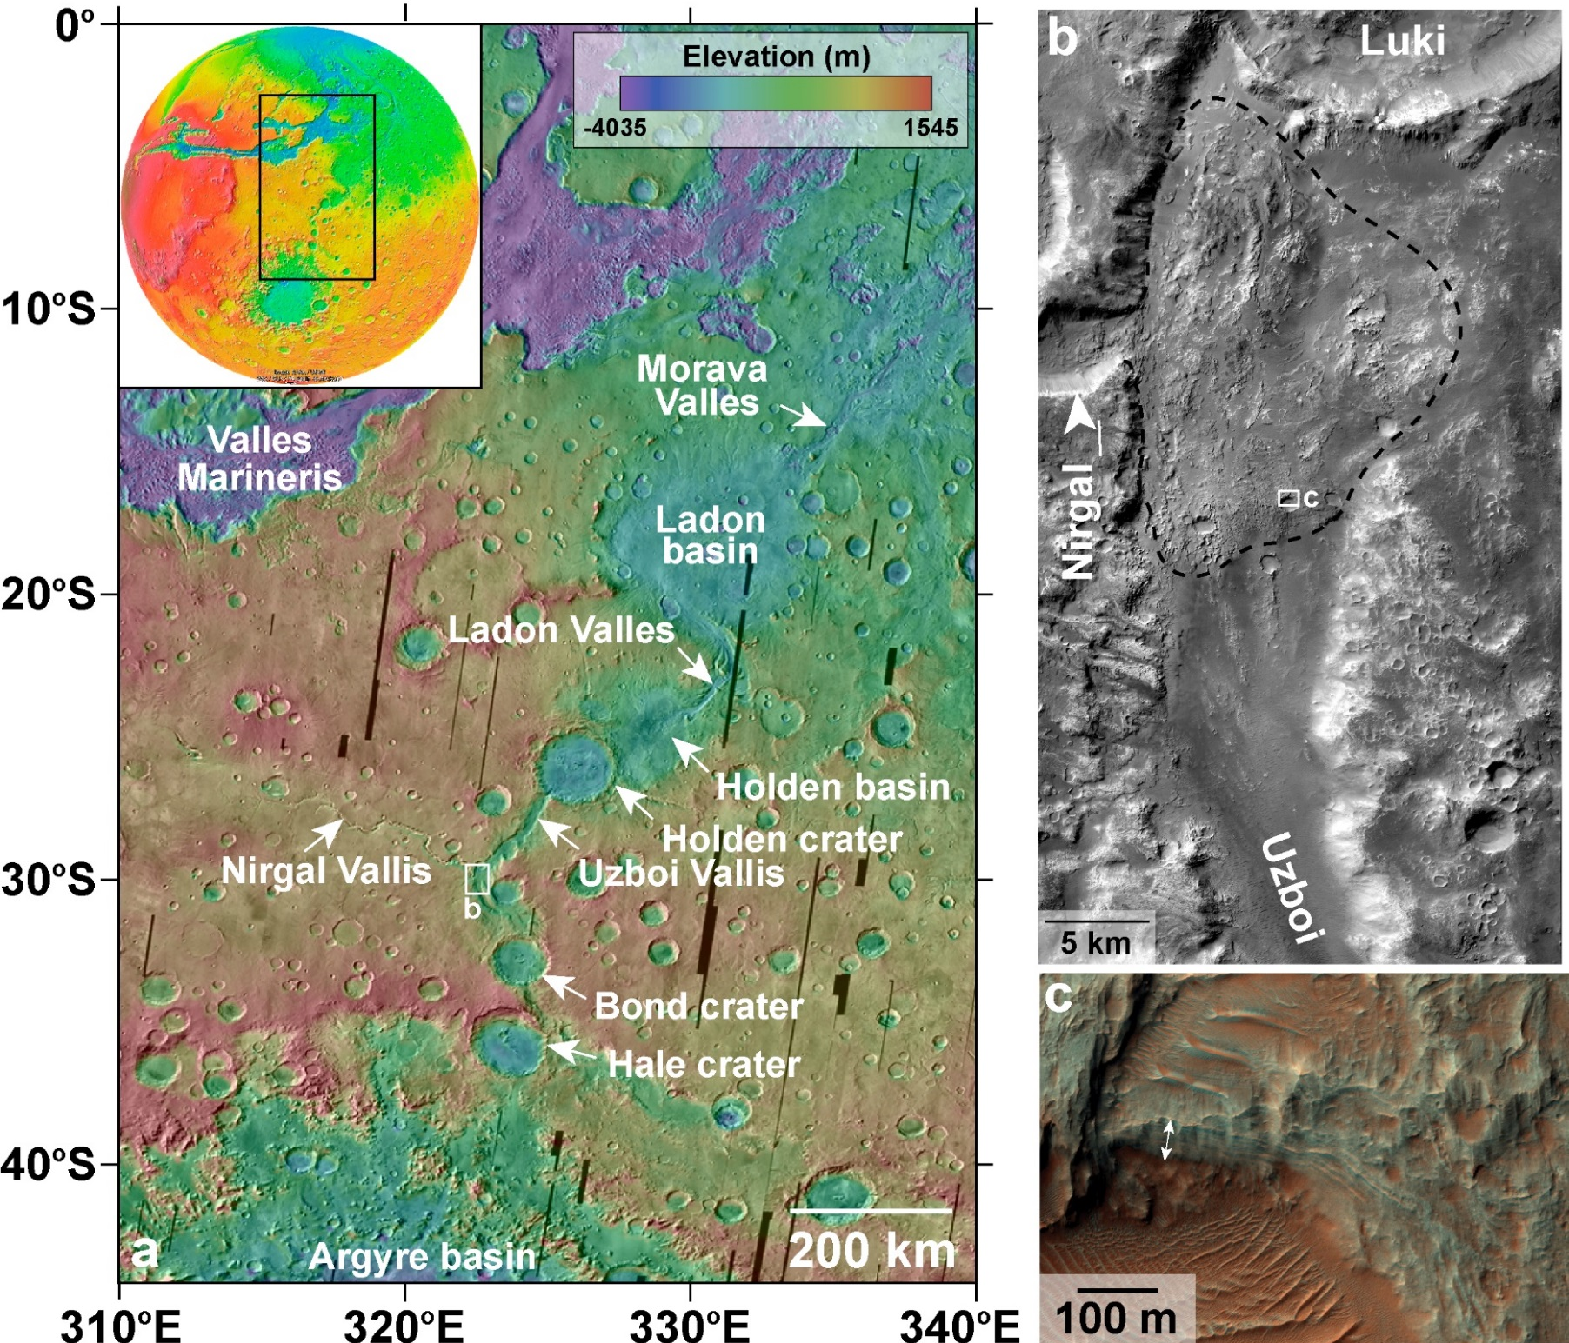


The Nature and Origin of Deposits in Uzboi Vallis
Background: One of the most impressive landscapes carved by liquid water on Mars occurs in Noachis Terra and Margaritifer Terra. Uzboi Vallis, Ladon Valles, and Morava Valles are a sequence of valleys that formed as water flowed into and out of depressions in the landscape, stretching from the southern highlands to the northern plains (Figure a). Understanding the role of water in this region of Mars – in particular the period in which it occurred and the length of time it persisted on the surface – provides important information about past climate conditions.
Study Results: A previously unrecognized mound of material on the floor of Uzboi Vallis occurs at the mouth of Nirgal Vallis, Uzboi’s largest tributary (Figure b). The lower part of the mound may have formed by a combination of material related to impact cratering, water-driven movement of sediment, or landslides. HiRISE images of the upper part of the mound, however, reveal a layered, fan-shaped deposit that formed as water flowed out of Nirgal and deposited sediment into Uzboi (Figure c). Thus, the climate environment in this region during the middle period of Mars’ geologic history (e.g., Hesperian) extends the window of time that the surface conditions may have been hospitable for life to form or persist.
Figure (a) The Uzboi-Ladon-Morava outflow system stretches from Argyre to the northern plains (see inset for global context). White box shows location of (b). MOLA over THEMIS daytime IR mosaic. (b) Fan-shaped deposit in Uzboi Vallis (black dashed line) at mouth of Nirgal Vallis. White box shows location of (c). CTX F16_042082_1494. (c) Sequences of layers exposed on fan surface. HiRISE ESP_042082_1495.
Citation: Wilson, S. A., Grant, J. A., Howard, A. D., & Buczkowski, D. L. (2018). The nature and origin of deposits in Uzboi Vallis on Mars. Journal of Geophysical Research: Planets, 123, 1842–1862. https://doi.org/ 10.1029/2017JE005508

