Slide 1
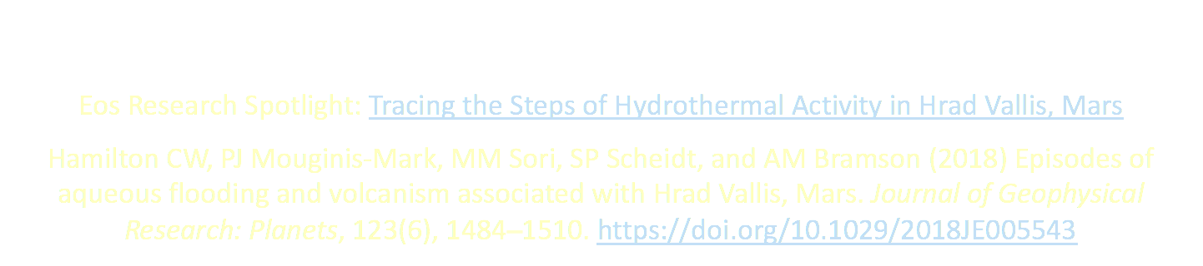
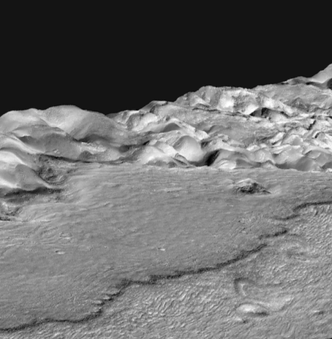
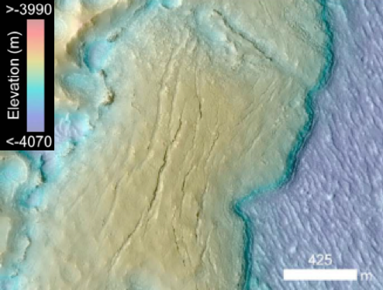
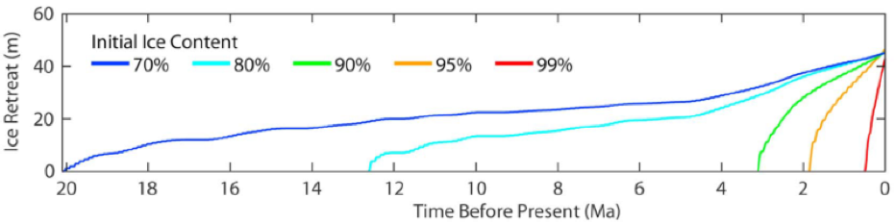



Key Points: Geomorphological characterization and numerical modeling of ice stability shows that flow units near Hrad Vallis are pāhoehoe (Hawaiian-style lava), not mud flow deposits.
The emplacement time of a
pāhoehoe flow of the observed thickness (50 m) would require decades (16–36 years).
Lava-induced hydrothermal systems in Hrad Vallis may have created habitable niches for life.
HiRISE-Derived Topography of a Hrad Vallis Flow Unit
Modeled Ice Retreat Rates Through Time
The authors acknowledge funding from the NASA Planetary Geology and Geophysics Program (NNX13AR14G) NASA Planetary Science Division (80NSSC17K0307), and NASA Earth and Space Sciences Fellowship Program (NNX16AP09H).

