Slide 1

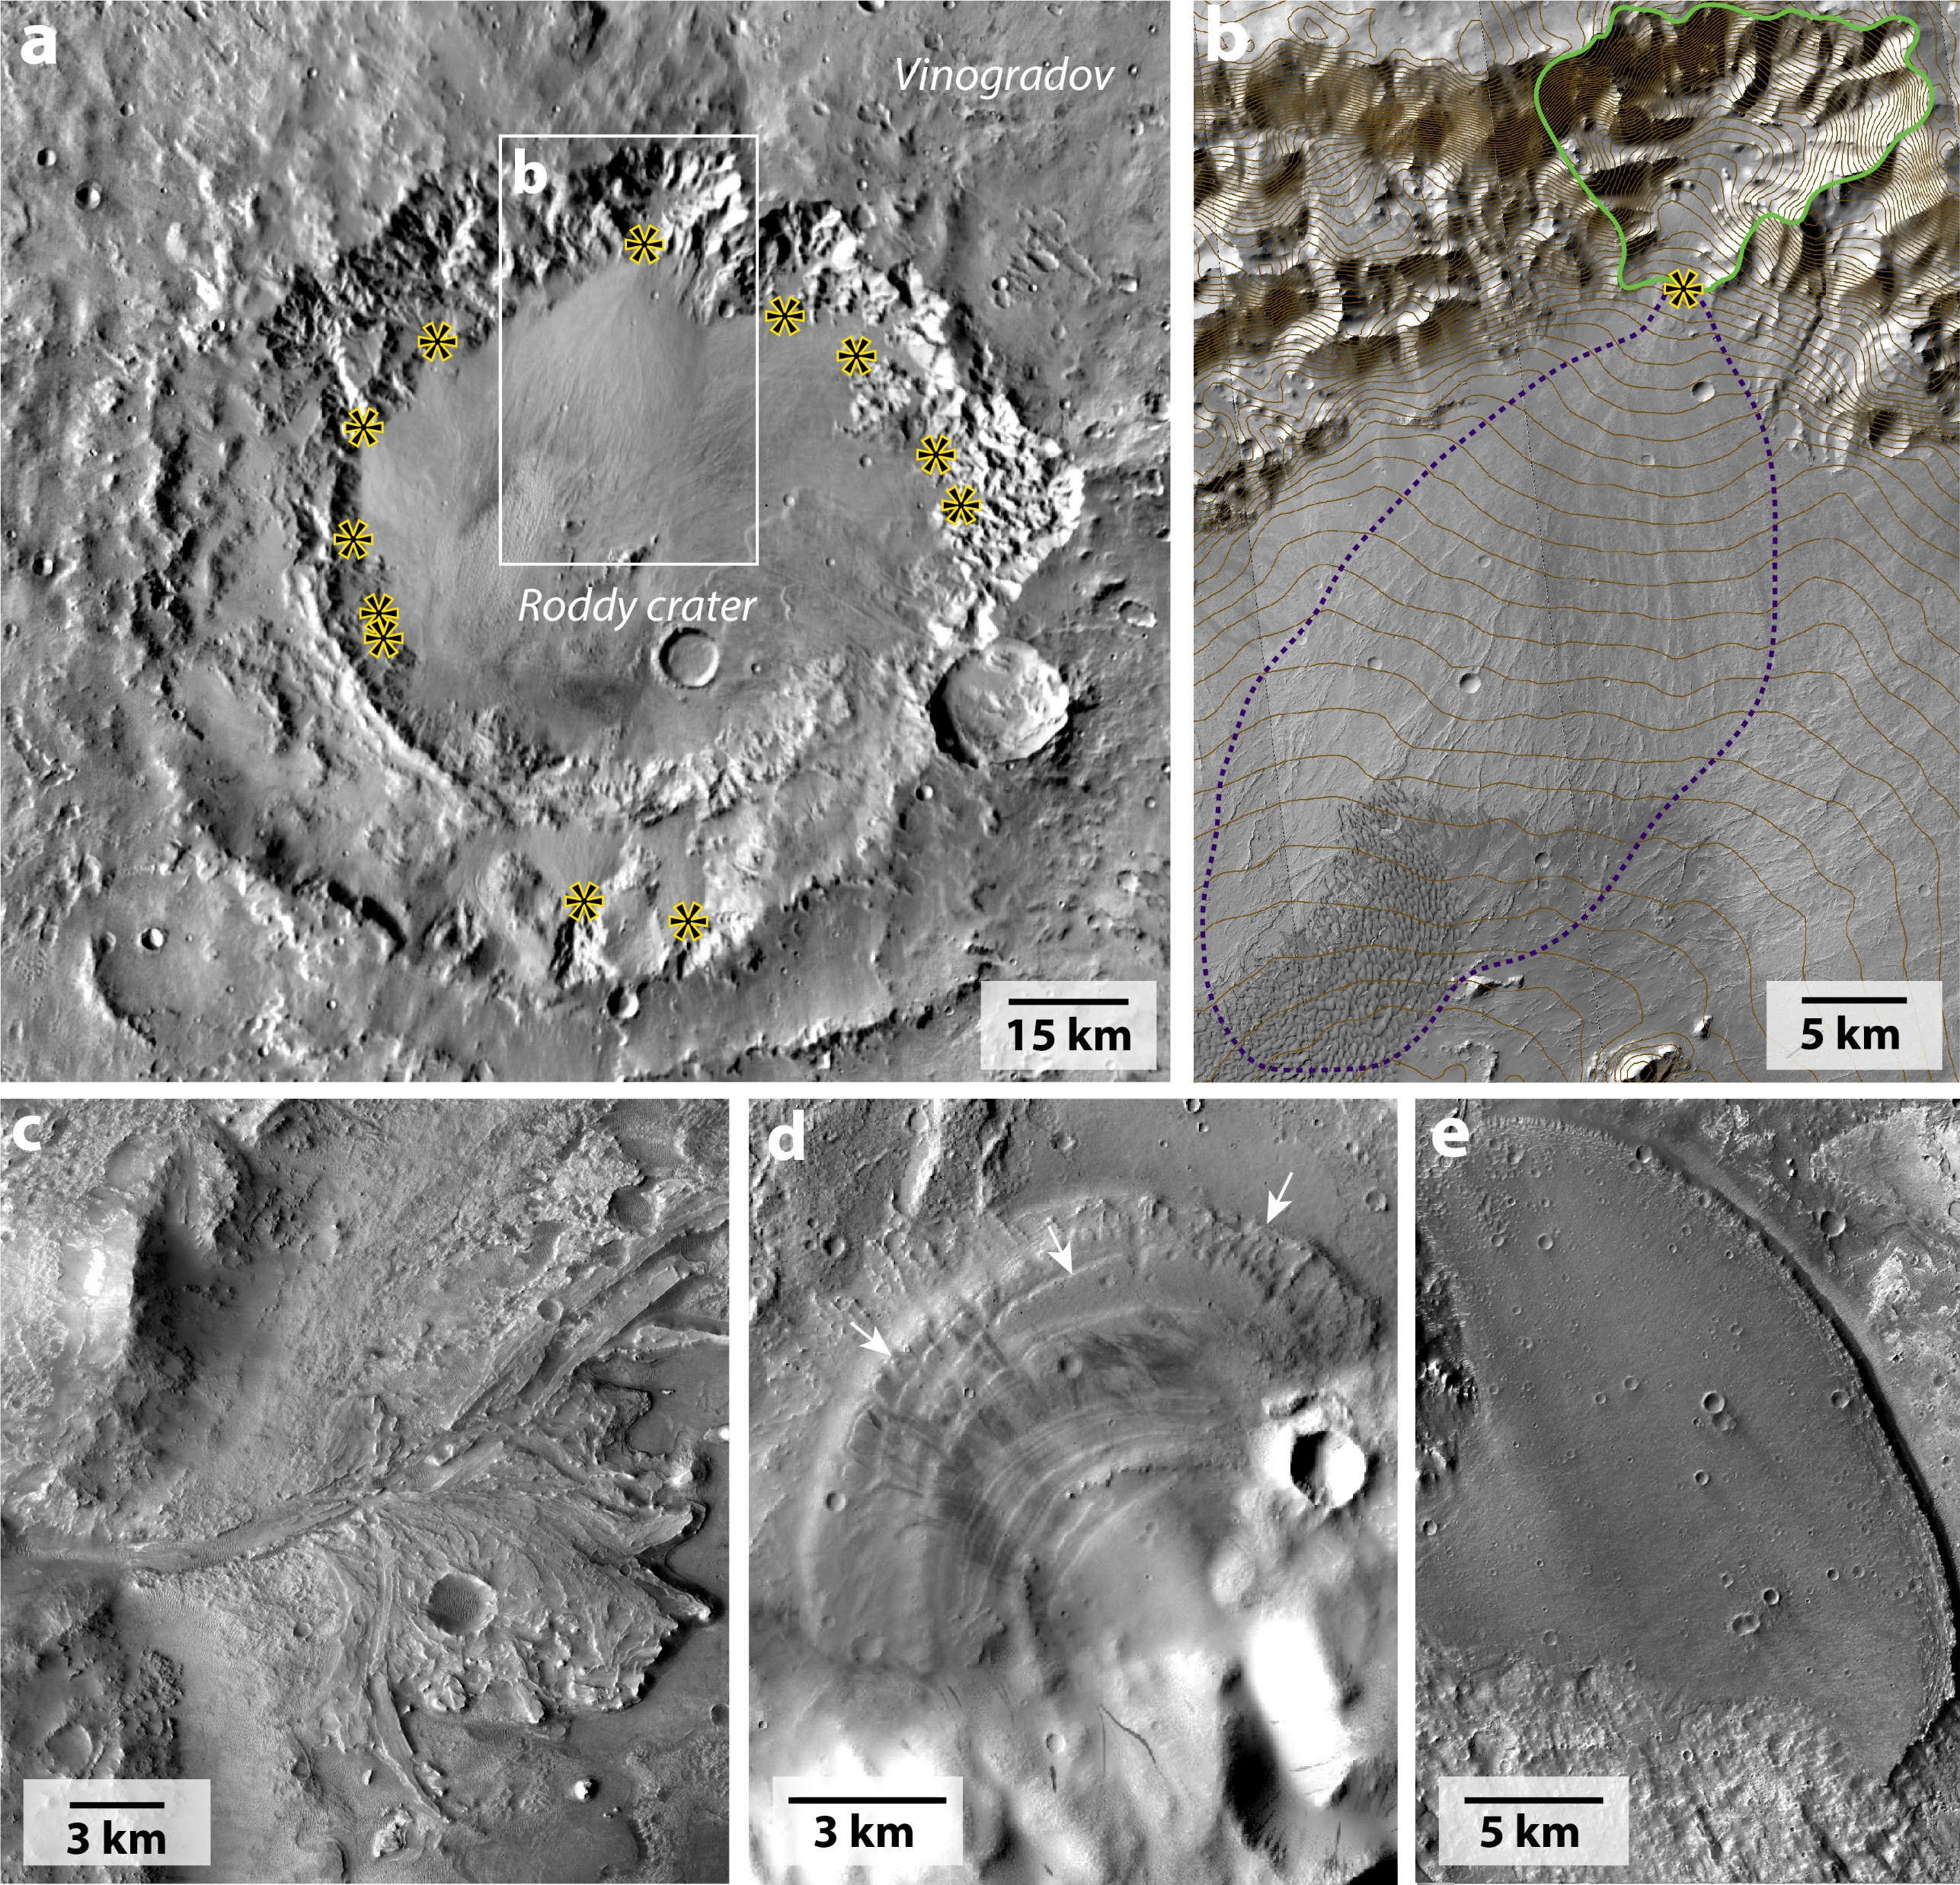
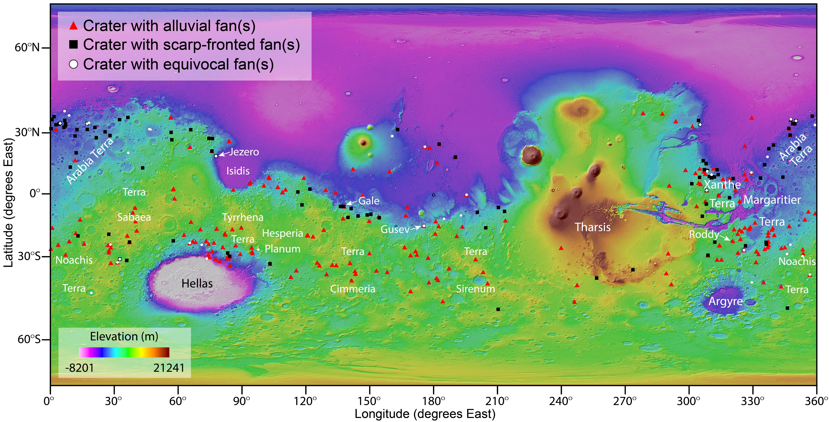
The Global Distribution of Craters With Alluvial Fans and Deltas on Mars
Motivation: Alluvial fans and deltas are interesting features because they required liquid water to form, and they preserve evidence of a past climate that was once very different than the cold and dry present-day conditions. But how common are these features? Determining where and when alluvial fans and deltas formed can provide clues about whether Mars was potentially habitable for life.
Highlights
We found 314 craters on Mars with alluvial fans (Fig. 1a-b) or deltas (Fig. 1c-e)
We identified 890 individual alluvial fans and 114 deltas
Craters with alluvial fans and deltas are numerous and widespread (Fig. 2)
Most alluvial fans formed in craters in the southern highlands, likely from seasonal melting of snow
Most deltas formed in craters in the northern lowlands where groundwater may have formed lakes (Fig. 2)
Alluvial fans and some deltas formed much later in Mars’ history than previously thought
Fig. 1. Examples of alluvial fans (a-b) and deltas (c-e) in craters on Mars. Alluvial fan apices are marked with a yellow star (a-b).
Methods: We searched orbital images from the Context Camera on board the Mars Reconnaissance Orbiter to find craters with alluvial fans and deltas.
Fig. 2. There are 314 craters that host alluvial fans (red triangles), putative deltas (black squares) or equivocal fans (white circles). The craters with alluvial fans are most abundant in the southern highlands whereas deltas most commonly formed in craters at lower elevations. Craters with alluvial fans and deltas have a mean size of ~50 km in diameter.
Published in Geophysical Research Letters in 2021 by Sharon Wilson, Alex Morgan, Alan Howard, and John Grant
https://doi.org/10.1029/2020GL091653

