Slide 1
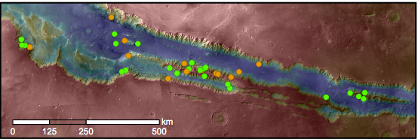
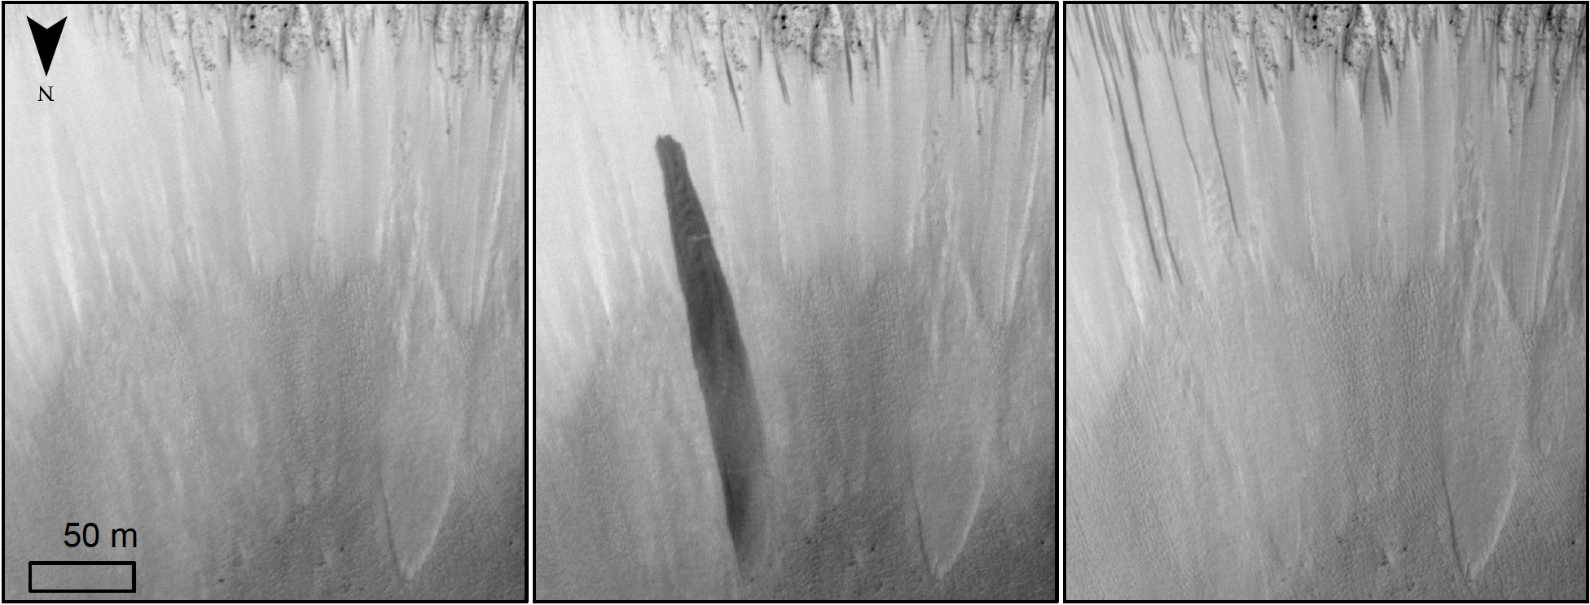
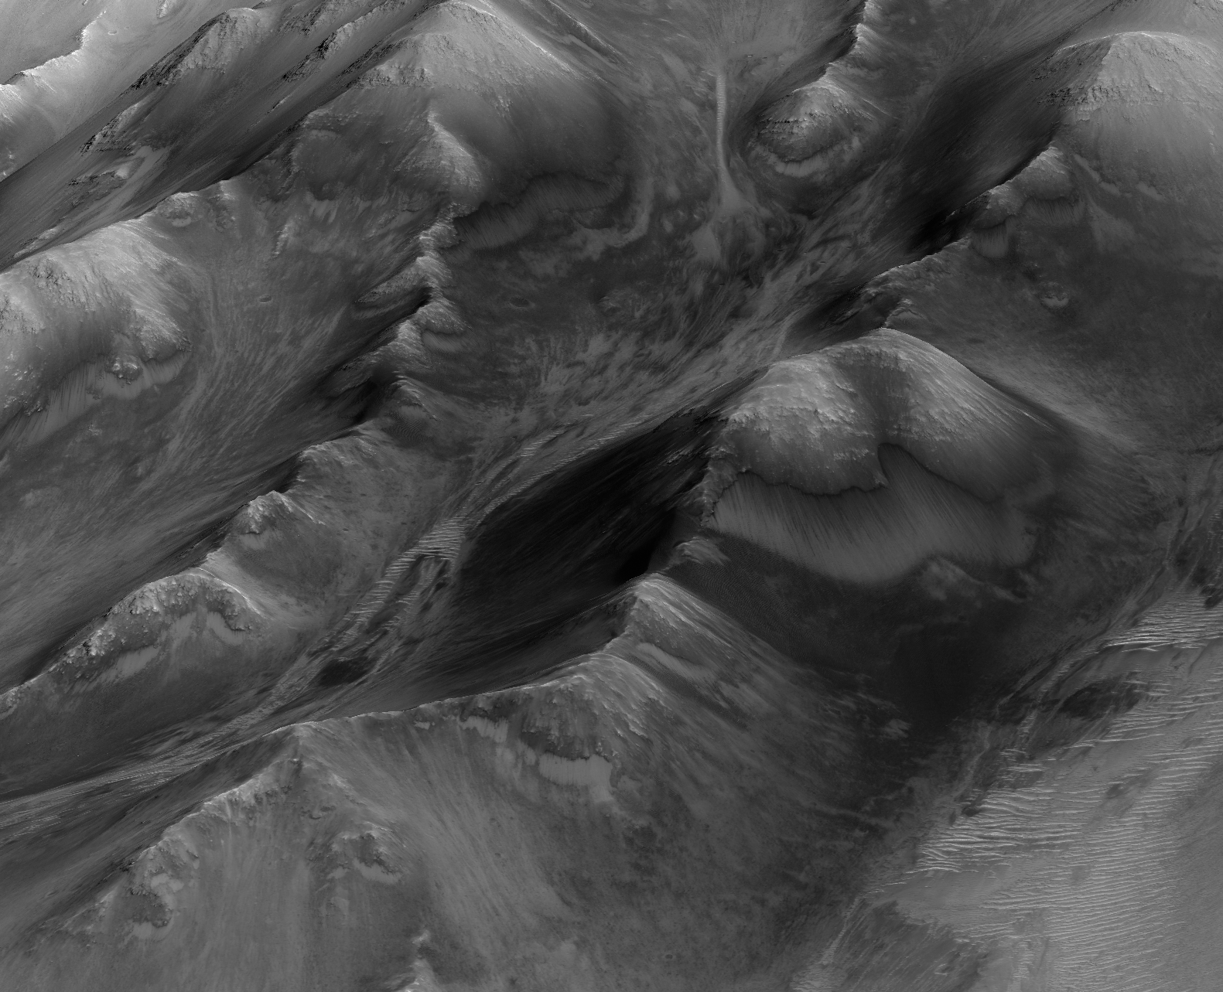
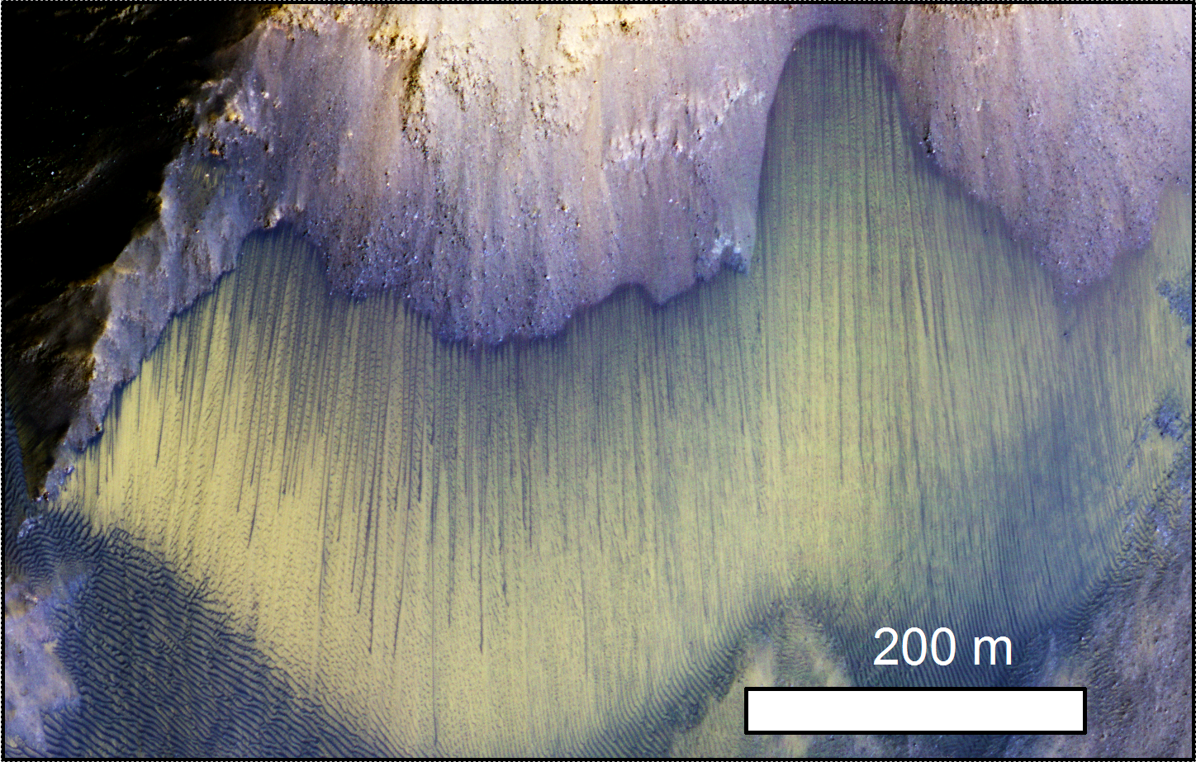


Geologic Context of Recurring Slope Lineae (RSL) in
Melas and Coprates Chasmata, Mars
Melas Chasma
Fully Confirmed
Partially Confirmed
Coprates Chasma
Map of Melas and Coprates Chasmata, Valles Marineris with 35 RSL HiRISE-monitored sites. The color of the symbol represents RSL site status and level of confidence. Map colors represent elevation where red is high and blue low.
A CTX northward prospective view of the Endeavour crater, showing two dune fields and the location of the Opportunity rover (gold star) during the investigation.
Topographic changes in Garni crater where RSL (black arrows) are found associated with a large slump (blue arrows). Also see: http://www.uahirise.org/ESP_035028_1685
Highlights
Coprates Montes
(left) A HiRISE perspective view of Coprates Montes where numerous RSL are found. View is approximately ~2.5-km-wide and derived from a HiRISE digital terrain model. See more at: http://www.uahirise.org/sim/
A HiRISE color view of large RSL forming below bedrock spurs.
RSL are dark, narrow flows that emerge from steep, rocky exposures, and incrementally grow, fade on a seasonal basis
Their strong temperature dependence and morphology suggests that liquid water occurs on or near the surface of Mars today
Widespread RSL sites are detected among diverse geologic landforms across Coprates and Melas Chasma
RSL are shown to be associated with and possibly cause minor topographic changes
Water budget estimates suggest a significant amount of near-surface water might be present
RSL are best monitored in images from the High Resolution Imaging Science Experiment (HiRISE) camera onboard NASA’s Mars Reconnaissance Orbiter (MRO).
Published in Journal of Geophysical Research - Planets in 2016 by
Matthew Chojnacki, Alfred McEwen, Colin Dundas, Lujendra Ojha, Anna Urso, and Sarah Sutton

