Slide 1
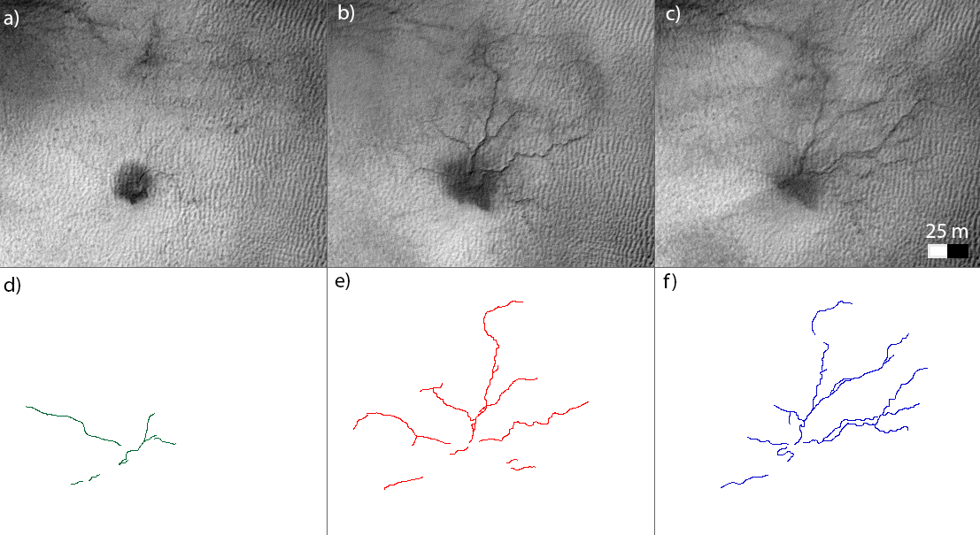
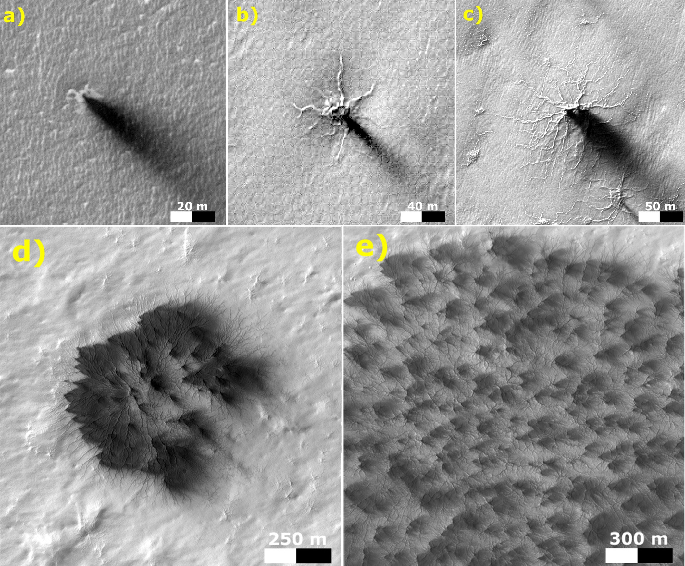
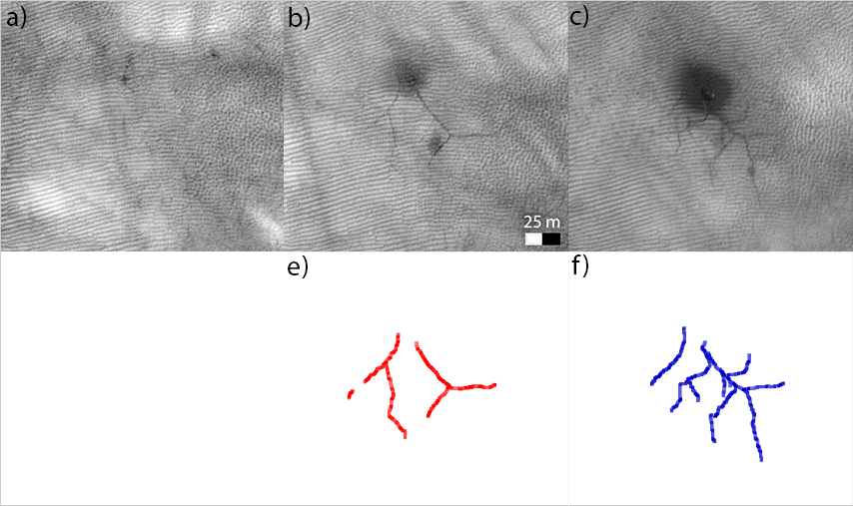


Cold CO2 jets create new spiders today
HiRISE detected new dendritic troughs during seasonal spring monitoring of the polar areas
Persistent changes in the polar landscape with direct connection to CO2 cold jets were observed for the first time.
The newly detected troughs are small shallow branching troughs (≈ 1.4 m wide) similar to the seasonal furrows on the dunes in the northern hemisphere.
The essential difference between the new troughs and furrows is that the troughs in the south are persistent while the northern furrows are erased each Martian year by sand movement due to summer winds.
Examples of development of dendritic troughs from one Martian year to the next (on the left) .
Dark blotches in the center are visible signature that earlier in spring CO2 jet was active here. From year to year the new southern troughs extend and develop new tributaries and their overall geometry turns from linear to dendritic, a characteristic shared with spider terrains elsewhere in the south polar region. Some troughs that are visible in one year are not visible in the next year – which indicates the probabilistic nature of this erosive process.
The same mechanism could be acting to create the much larger araneiform terrains.
The top right sequence illustrates possible stages of araneiform development from primitive depression with one trough to an expanded araneiform network.
MY 29
MY 30
MY 30
Several years of HiRISE observations provide us with information about the current rate of erosion by cold CO2 jets. From it we estimate minimum ages of the araneiforms and the surface into which they are carved to be
1.3 × 10³ Martian years.
MY 30
MY 31
MY 32
G. Portyankina, C. J. Hansen, K-M. Aye (2016), Present-day erosion of Martian polar terrain by the seasonal CO2 jets,
Icarus, Volume 282, 15 January 2017, Pages 93-103, ISSN 0019-1035, http://dx.doi.org/10.1016/j.icarus.2016.09.007

