Slide 1
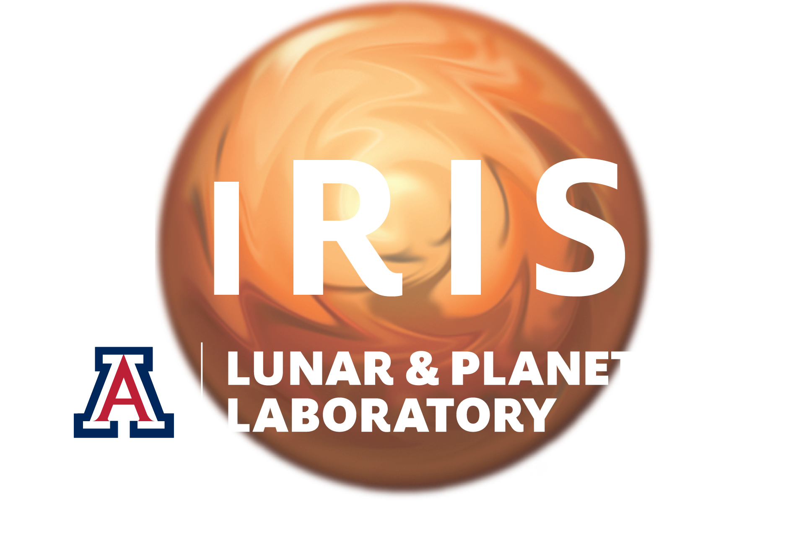
Catalog of New Martian Craters
More than 1,200 impacts on Mars have been recorded in the last few decades.
New craters are mostly small: from 58 m across down to smaller than can be measured
More than half of these impacts formed a cluster of craters versus a single crater.
The area around the impact is usually dark, but can be light- or dual-toned, and includes different features like linear rays and diffuse halos.
Surfaces covered with bright dust lacking cohesion are favored to form detectable surface features.
More small craters form than large ones, but that difference is smaller on Mars than the Moon.
Examples of types of albedo features found around new date-constrained impacts on Mars.
Row 1: dual-toned single craters. Row 2: single craters. Row 3: clusters of craters. The leftmost column all have rays (as well as other features), the middle column all have halos, and the rightmost column all have rays as well as halos. Image credit: NASA/JPL/UArizona.
Ingrid Daubar et al. (2022) J. Geophys. Res. – Planets
https://doi.org/10.1029/2021JE007145

