Slide 1
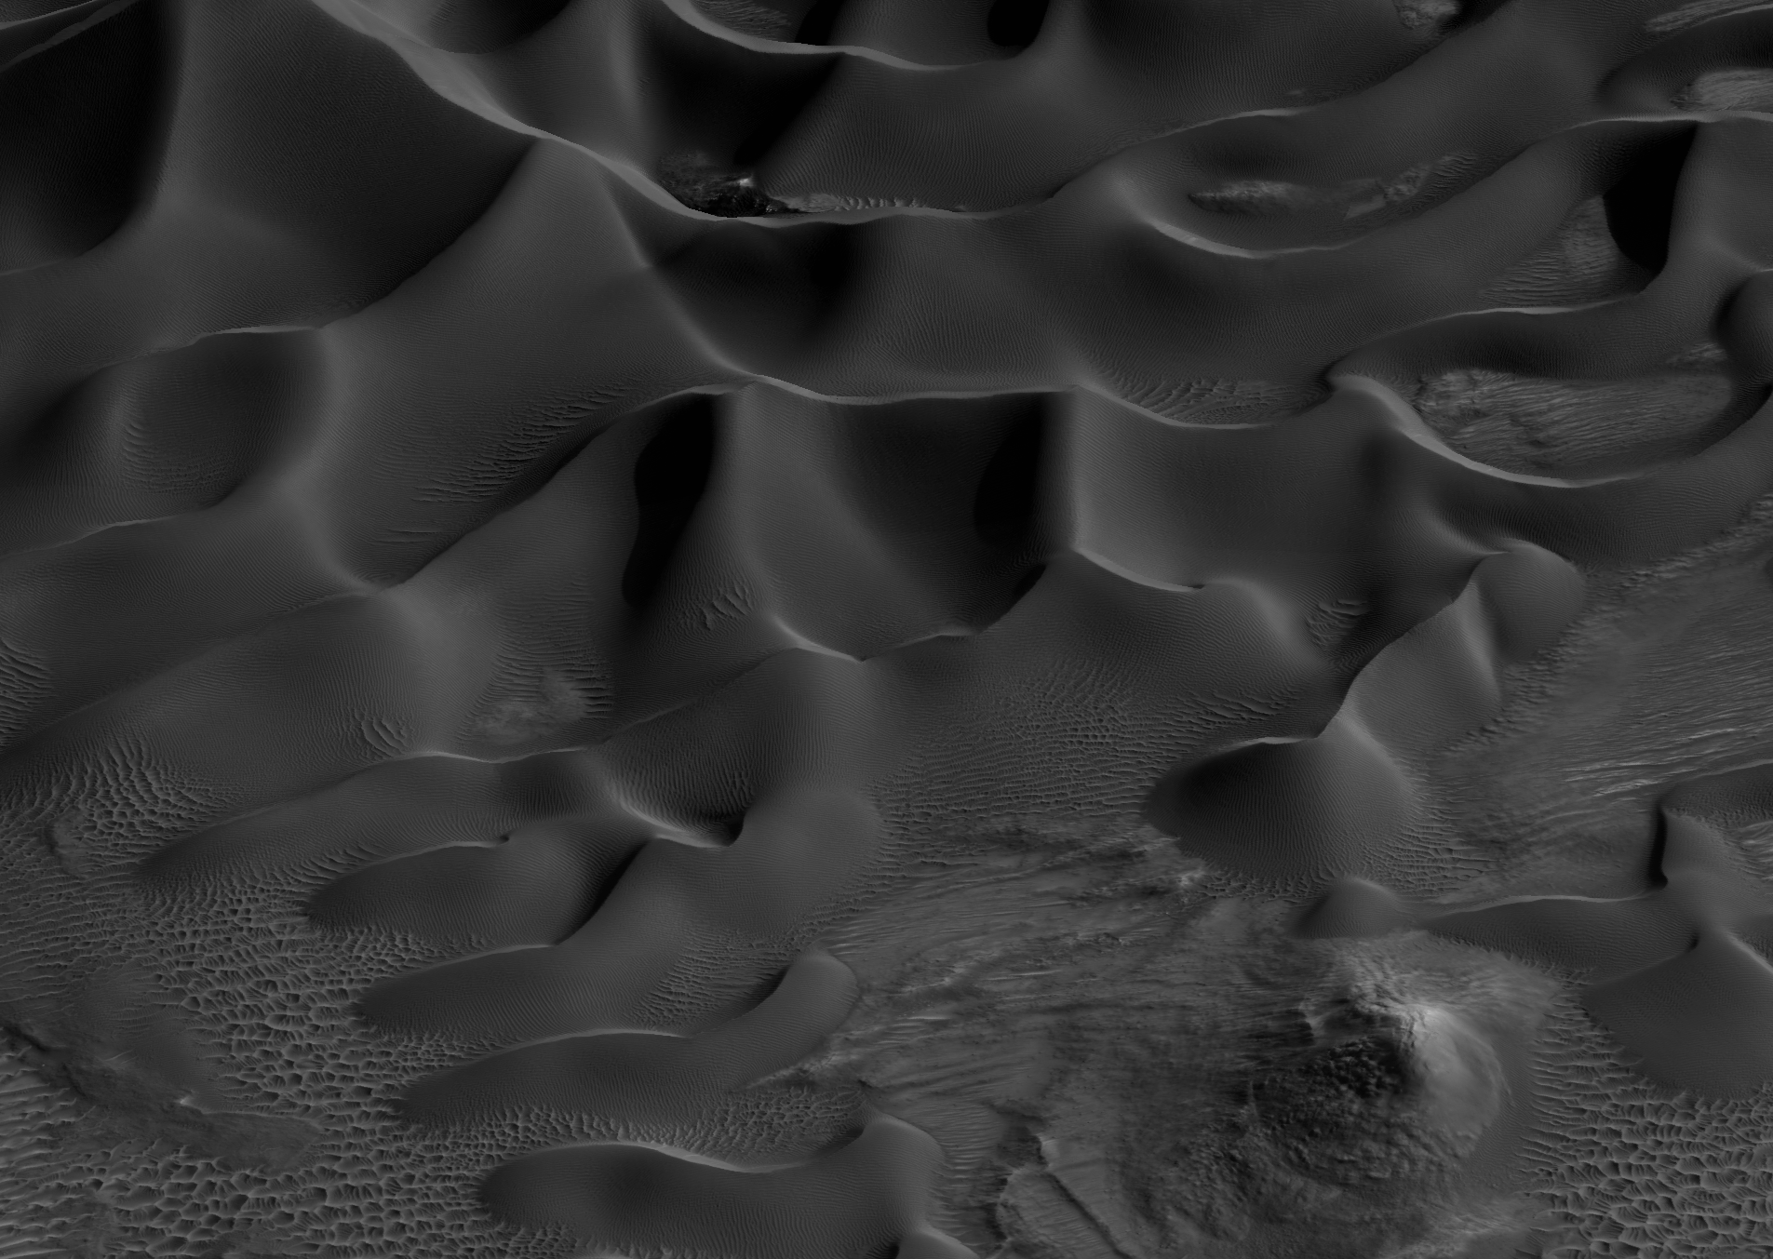


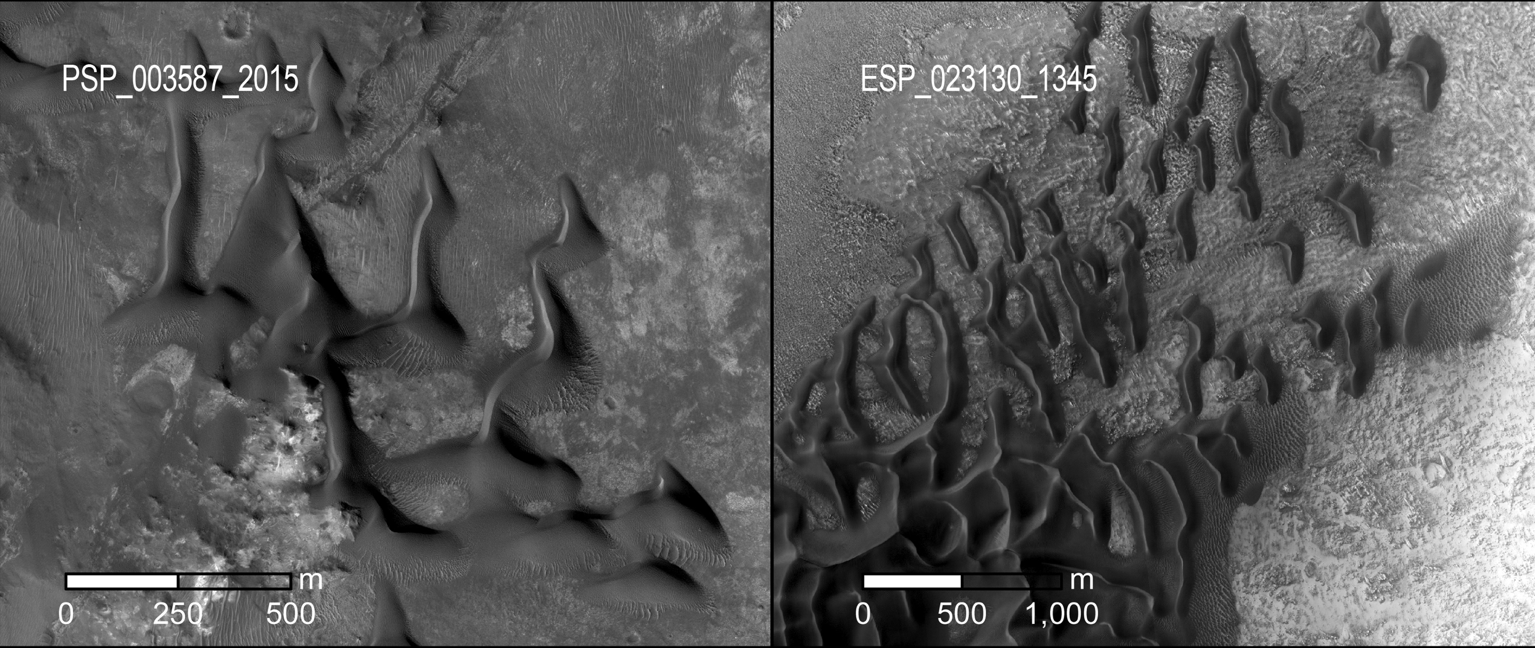
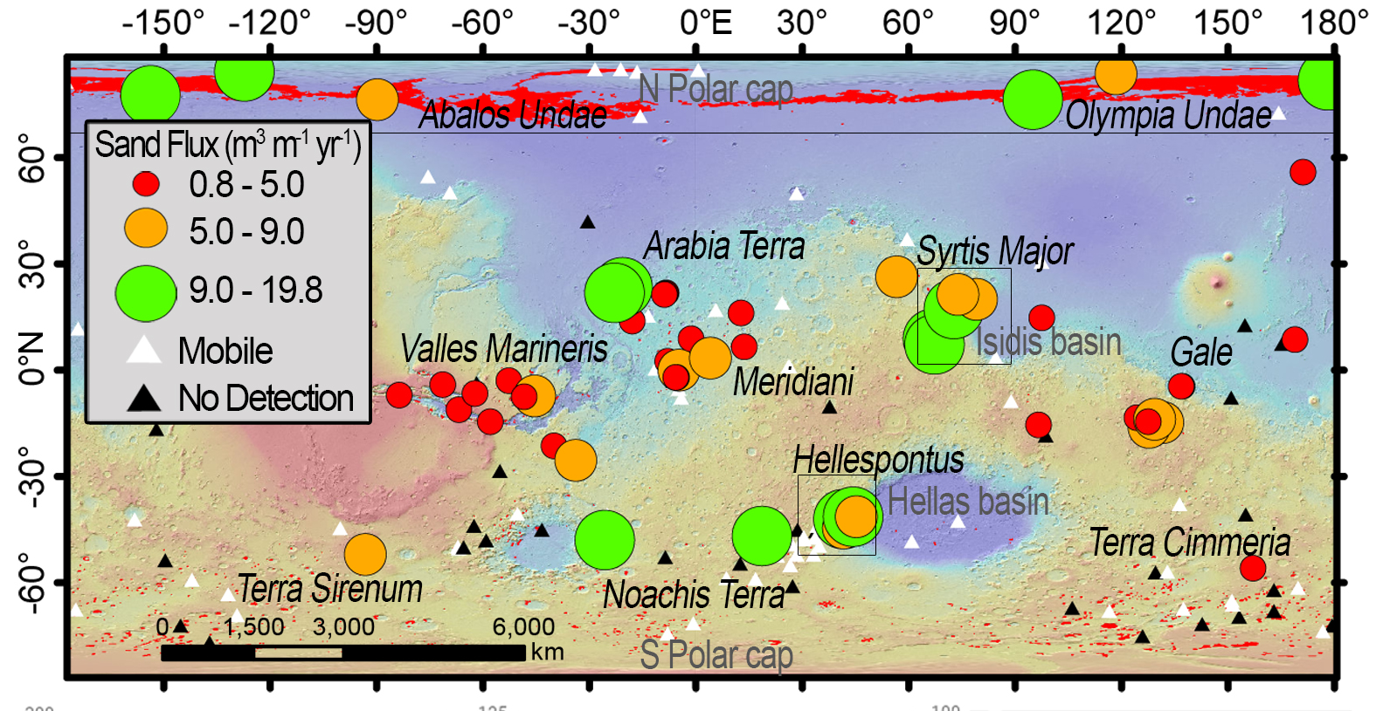
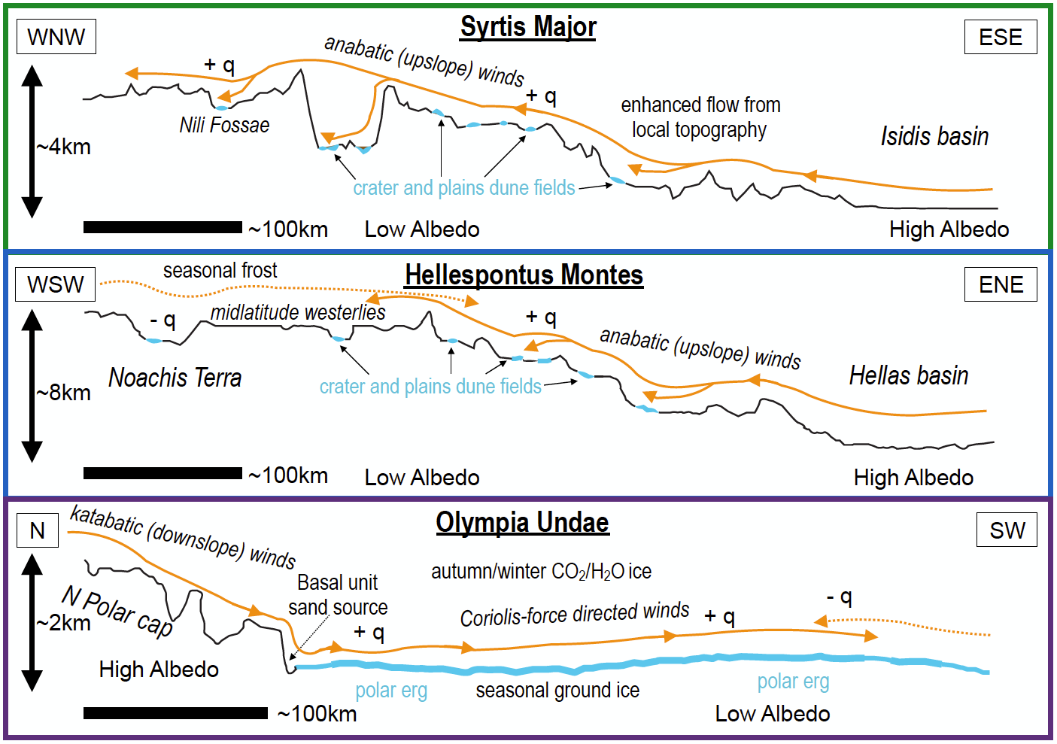
Boundary condition controls on the high sand flux regions of Mars
Highlights
Bedform heights, migration rates, and sand fluxes all span two to three orders of magnitude across Mars (Fig. 1), but we found that areas with the highest sand fluxes are concentrated in three regions: Syrtis Major, Hellespontus Montes, and the North polar sand seas (Fig. 2).
All regions are located near prominent transition zones of topography (e.g., basins, polar caps) and thermophysical properties (e.g., albedo variations); these are not known to be critical terrestrial boundary conditions (Fig. 3).
Results suggest that, unlike on Earth, large-scale topographic and thermophysical variability play a leading role for driving sand fluxes on Mars.
Background
Wind has been an enduring geologic agent throughout Mars’ history, as evidenced by the migration of aeolian sandy bedforms (dunes and ripples), but it is often unclear where and why sediment is mobile.
The spatial variations in bedform transport parameters relate to external forcing factors (i.e., boundary conditions), some of which may be unique to the red planet.
We investigated whether aeolian bedform (dune and ripple) transport rates are depressed or enhanced in some areas by local or regional boundary conditions (e.g., topography, sand supply, seasonal factors).
Figure 2. HiRISE images of high-sand flux dune fields in (left) Syrtis Major (near Mars2020 landing site Jezero crater) and (right) Hellespontus Montes. Image Credit: NASA/JPL-Caltech/University of Arizona
Figure 3. Schematic representation of regional boundary conditions. MOLA topographic profiles where thicker blue lines indicate locations of dune fields and increased sediment supply. Primary (orange solid lines) and secondary (orange dashed lines) wind regimes, along with locations of relatively high (+ q) and low (- q) sand fluxes are shown.
Figure 1. Map of volumetric sand flux measurements for 54 dune fields (graduated circles), bedform mobility detection status (triangles (Banks et al., 2015, 2018)), and dune field distributions (red polygons) (Hayward et al., 2014). The three high sand flux regions of Syrtis Major, Hellespontus Montes, the North polar erg are outlined in black. Base map is colorized MOLA elevation from +4 (red) to -5 km (blue).
Published in Geology in 2019 by Matthew Chojnacki, Maria Banks, Lori Fenton, and Anna Urso.
https://pubs.geoscienceworld.org/gsa/geology/article/569256/

