Slide 1
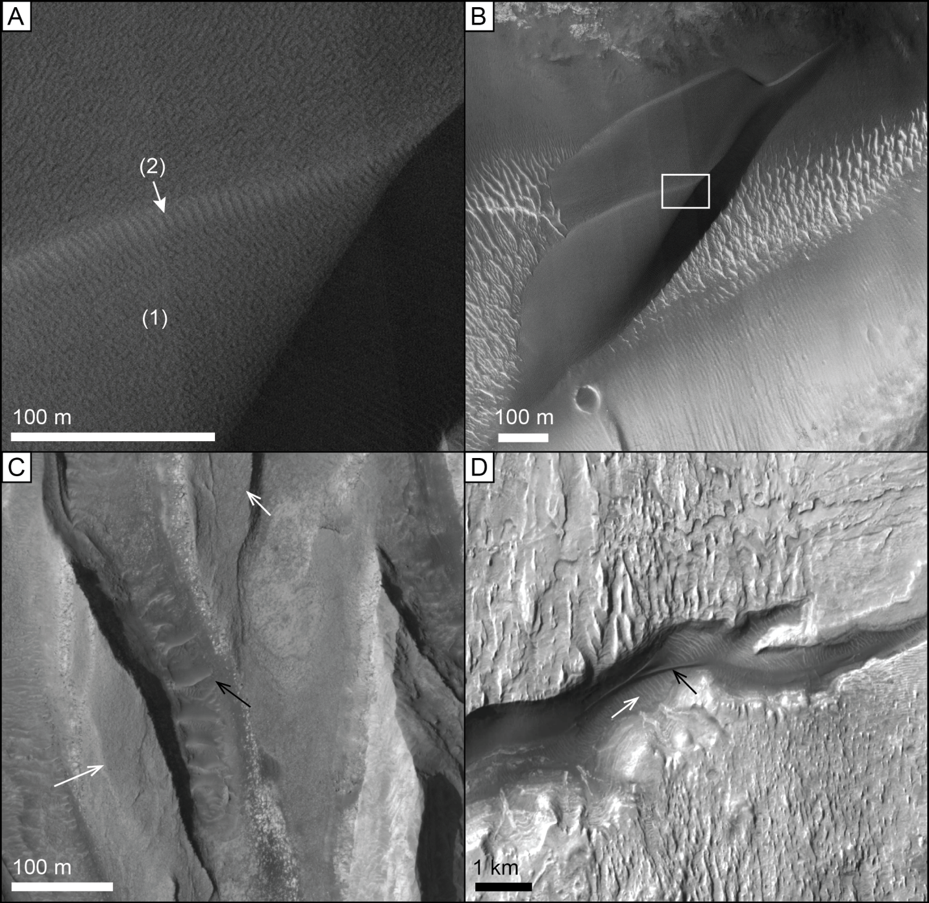
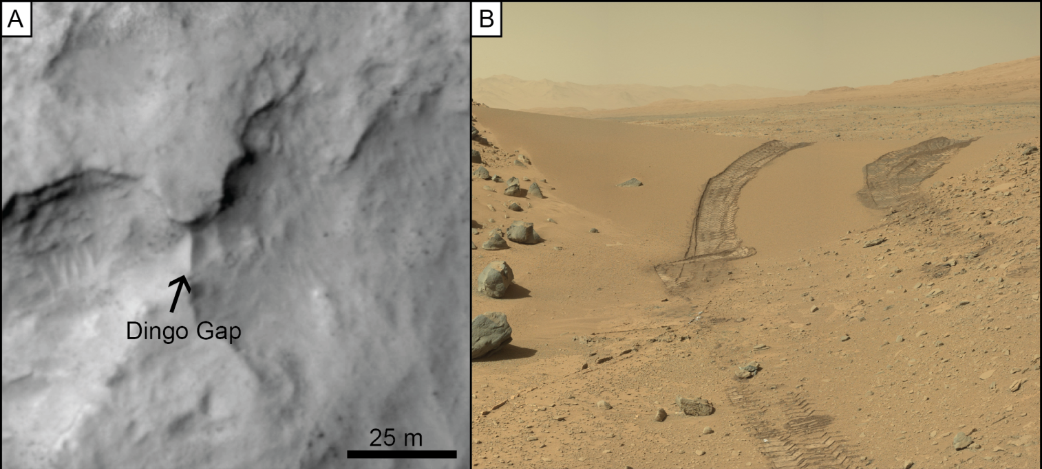
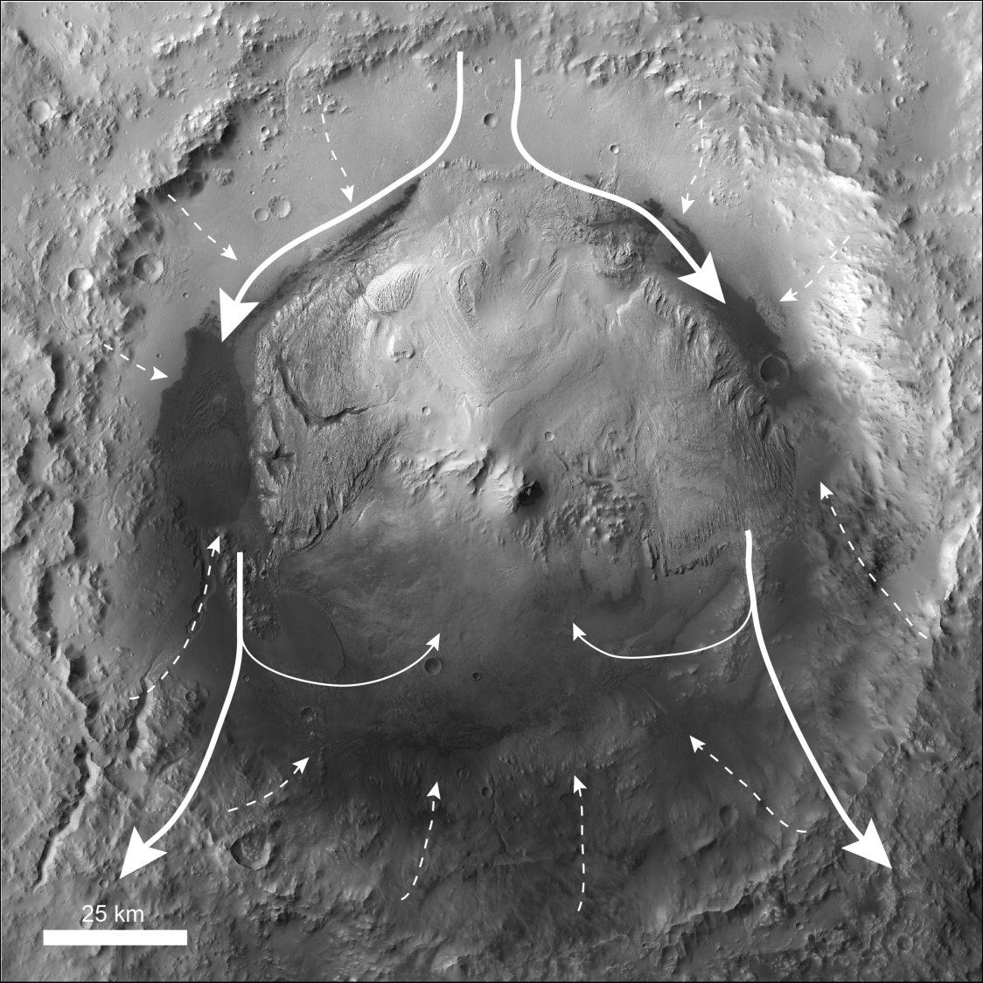


Observations of an Aeolian Landscape: Gale Crater, Mars
(Above, ESP_036128_1755) Dingo Gap: A transverse aeolian ridge as seen by HiRISE (A) and MSL rover Curiosity (B).
Channel containing Fe-allophane/opal (red arrows). Portion of HiRISE image PSP_008141_1645.
(Above, ESP_019698_1750) Superposition of wind-formed features used to reconstruct wind circulation in Gale crater. A) Fluid drag ripples form on the stoss (1) and reworked lee (2) faces of a dune. B) The same dune from A (white box) migrating over a field of transverse aeolian ridges. C) Transverse aeolian ridges (black arrow) between yardangs (white arrow). D) Transverse aeolian ridges (white arrow) with a dune (black arrow) in a canyon cut through a yardang field.
(Right) Major wind circulation patterns in Gale crater reconstructed from wind-carved features at the surface. Thin arrows show northerly winds entering the crater and diverging around Mount Sharp, with eddies shed in the mountain’s wake. Dashed lines show subordinate katabatic or slope flow winds.
HiRISE DTM perspective view at 2X vertical exaggeration with CRISM spectral parameters overlain in color. Red arrows identify an Fe-allophane/opal deposit (whitish blue), which extends across 940 m in elevation, whereas green arrows identify exposures of smectites within the wallrock (yellow-light green).
Results published by Day, M., and G. Kocurek, Icarus, vol 280, 2016.

