Slide 1
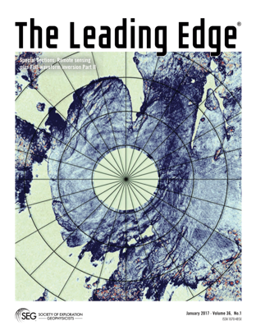
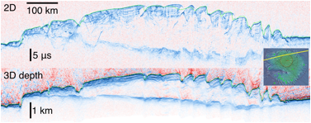

3-D Imaging of Martian Polar-Cap Interiors Sheds New Light on Climate History
Source: The Shallow Radar (SHARAD) experiment aboard the Mars Reconnaissance Orbiter
3-D Volumes: Using SHARAD data from more than 2000 2-D orbit passes over each pole, the team created 3-D images of the interior of both polar caps. Each volume covers more than 600 times the area of Earth’s largest 3-D seismic survey.
Findings: Geometric corrections and summing provided by 3-D radar imaging have revealed layering and structures such as a volume of sequestered CO2 ice larger than expected in the south, as well as likely buried impact craters in both caps.
Importance: The climate history of Mars is recorded in polar-cap layering and CO2 ice deposits. Volumetric cratering records may be used to determine the age of each polar ice cap independently of climate models.
Reference: Foss II, F.J. et al. 2017. 3-D Imaging of Mars’ Polar Ice Caps Using Orbital Radar Data. The Leading Edge 36 (cover story), 43-57.

